Slide 1
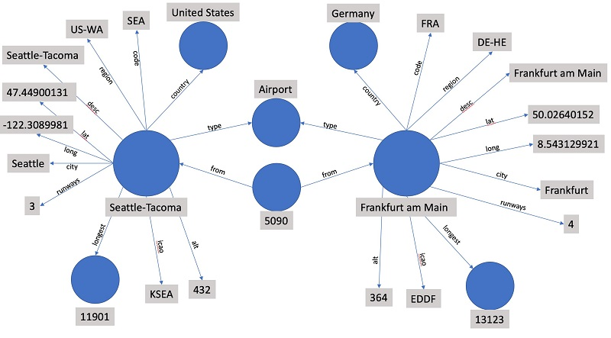


Slide 2

Learning
001
SPARQL
(opening & intro)
Author: Bob DuCharme
Xiaoqi Zhao, GitHub: https://github.com/yasenstar/Learn_SPARQL

Slide 3
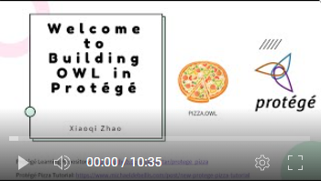
Opening & Intro
About the Book
Learning Notes and Practical Code – GitHub (& Gitee)
https://github.com/yasenstar/Learn_SPARQL
https://gitee.com/yasenstar/Learn_SPARQL
Mindmap – by FreePlane
Video series – to be added to YouTube (and others)
Reference Videos: Ontology Practice – pizza.owl by Protege

Slide 4
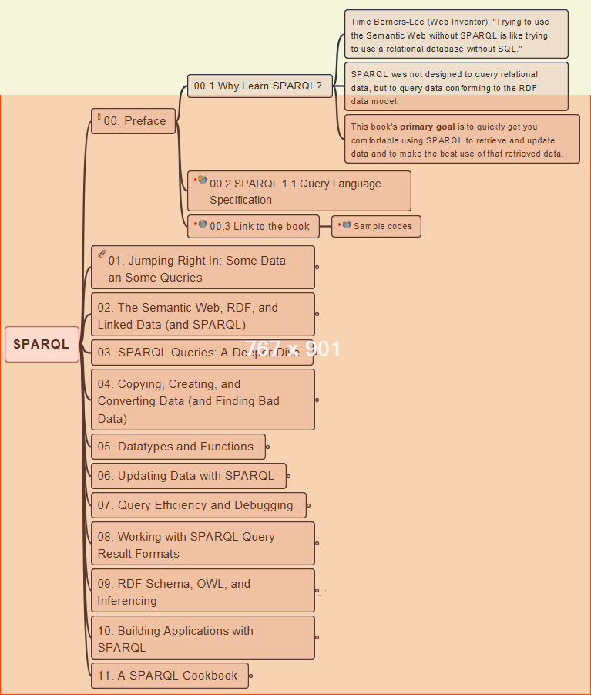
00- Preface
002
Why SPARQL and Resources

Slide 5
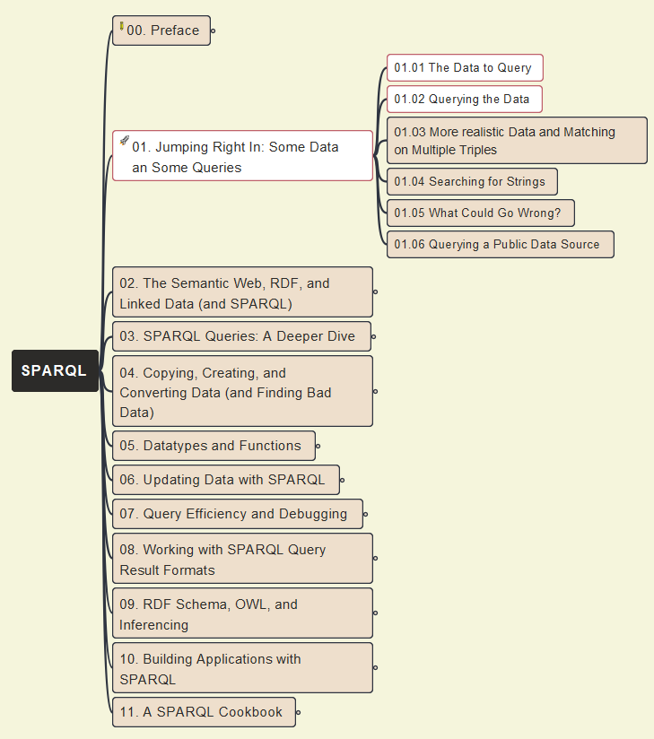
01- Jumping Right In
003
Initial Data Query and Jena (ARQ) Tool

Slide 6
01- Jumping Right In
004
Initial Data Query (cont.)

Slide 7

01- Jumping Right In
005
Initial Data Query (cont.): use Protégé to Query Data

Slide 8
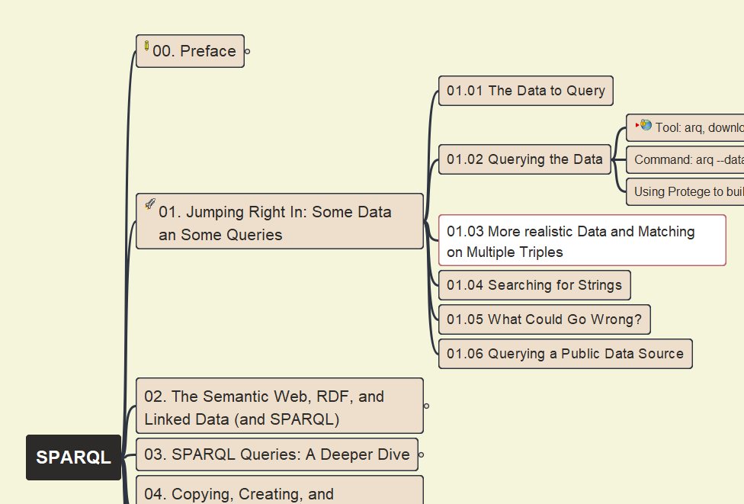
01- Jumping Right In
006
More Realistic Data and Matching on Multiple Triples

Slide 9
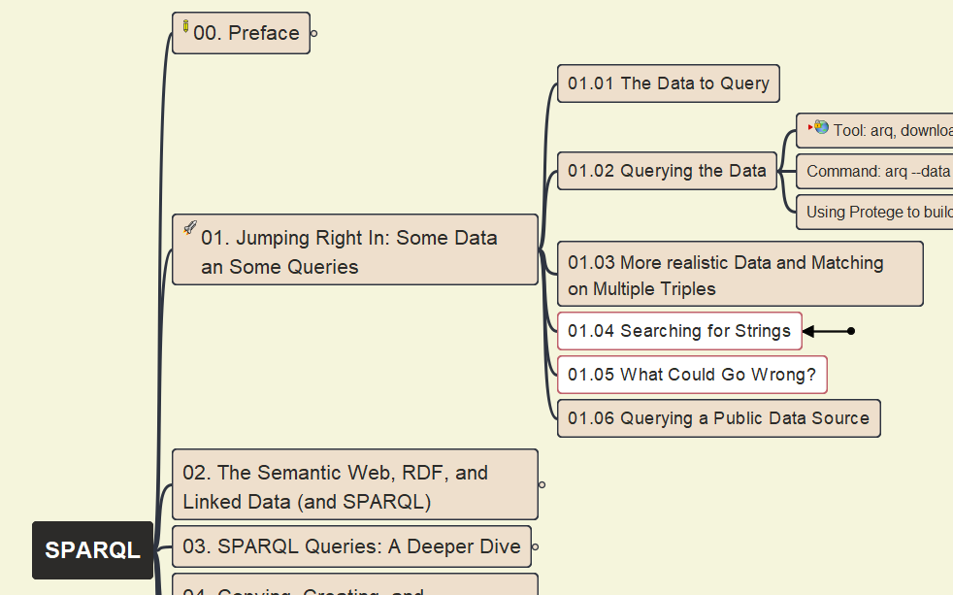
01- Jumping Right In
007
01.04 Searching for Strings
01.05 What Could Go Wrong?

Slide 10
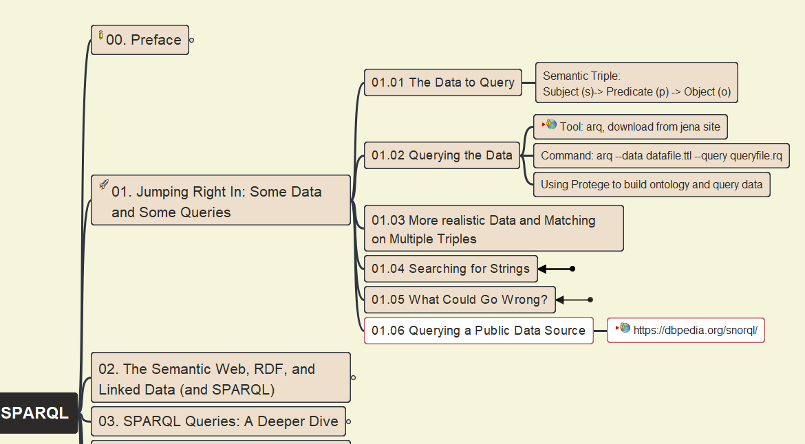
01- Jumping Right In
008
01.06 Querying Public Data Source

Slide 11
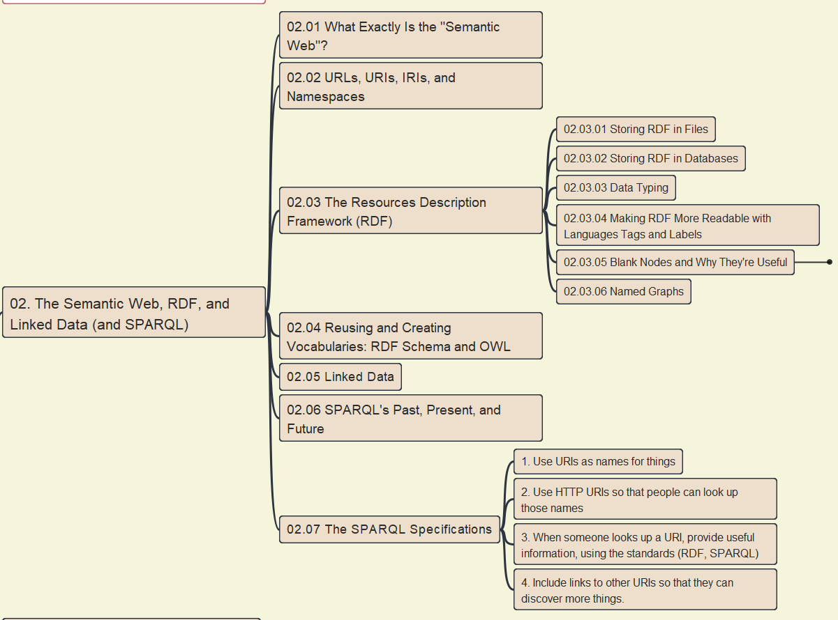
02- The Semantic Web, RDF, Linked Data (& SPARQL)
009
02.01 What is Semantic Web?

Slide 12
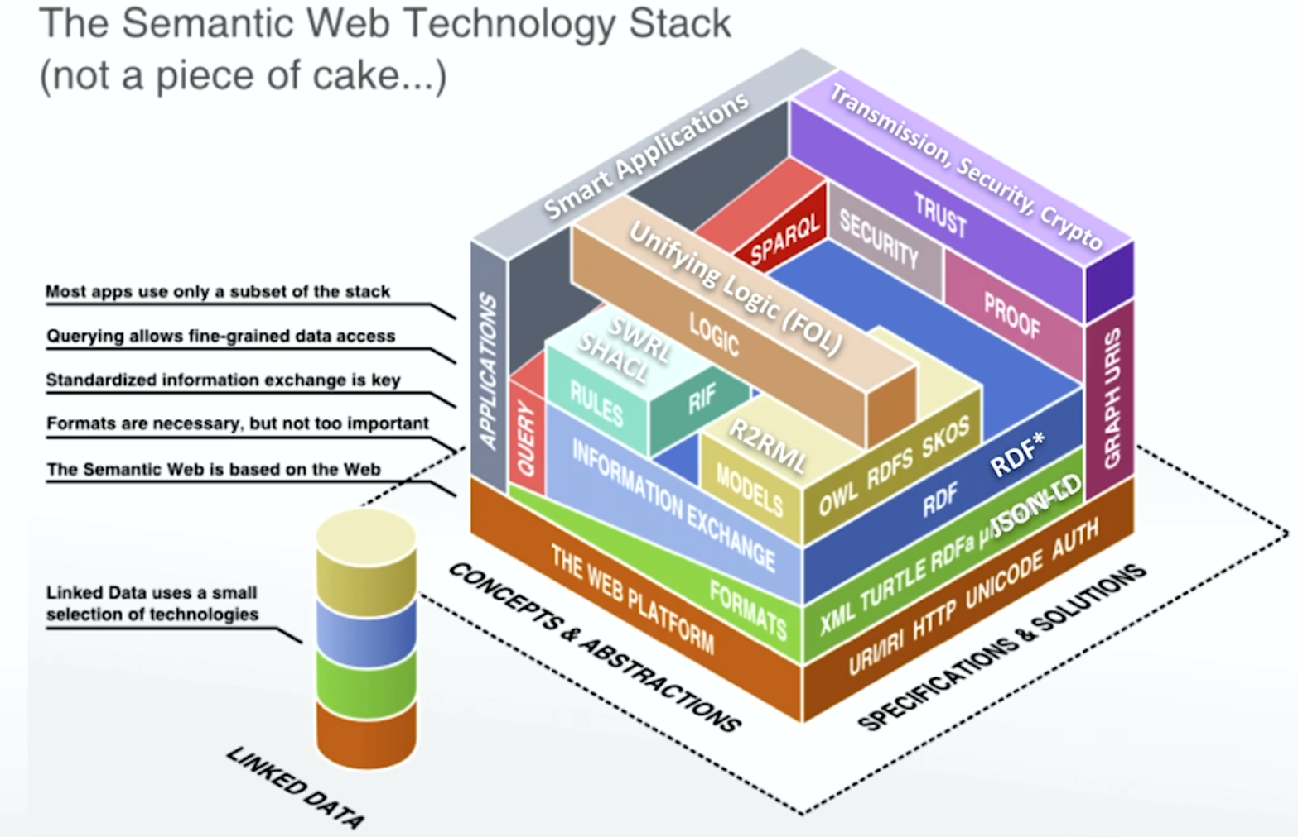
The Semantic Web Technology Stack
Source: OpenHPI training

Slide 13
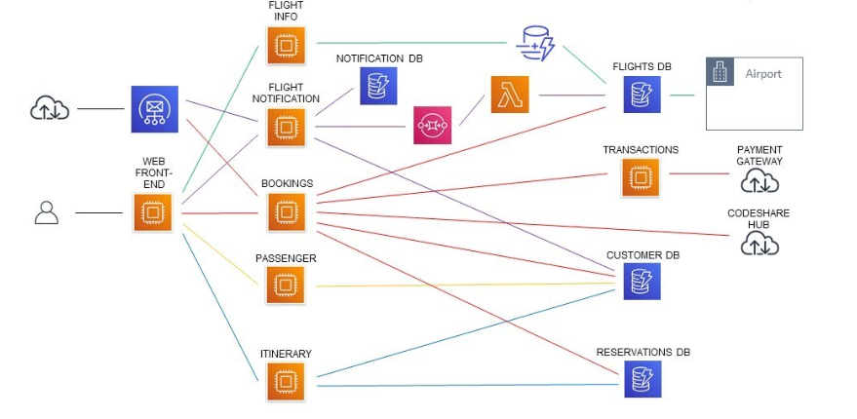
Airline Reservation System – Sample Architecture
Source: https://www.youtube.com/watch?v=bV1_R4XQZDY

Slide 14
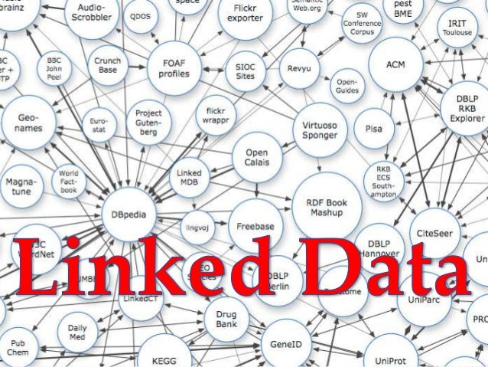
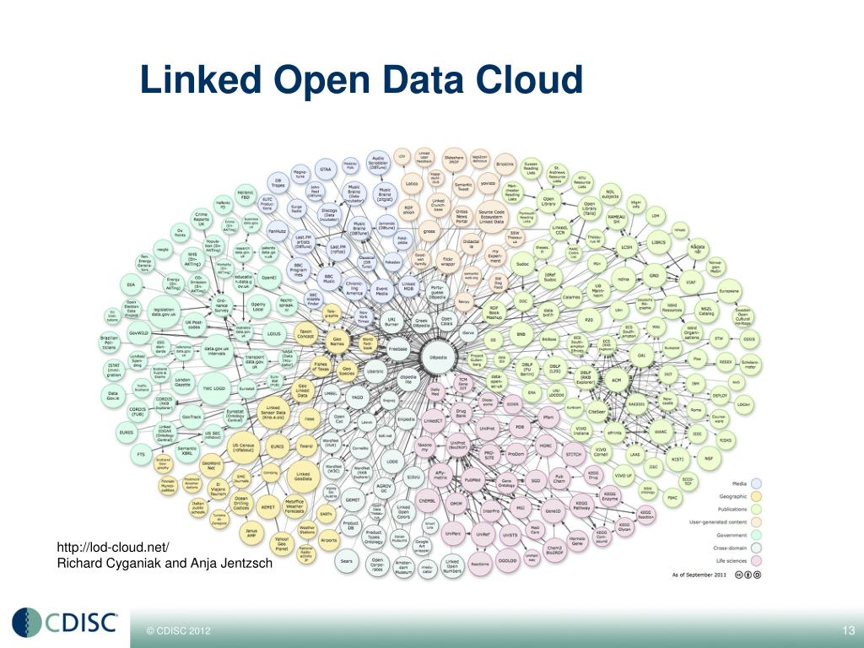
Linked Data – Best Practices

Slide 15
02- The Semantic Web, RDF, Linked Data (& SPARQL)
010
02.02 URLs, URIs, IRIs, and Namespaces

Slide 16
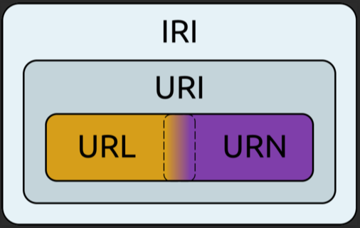
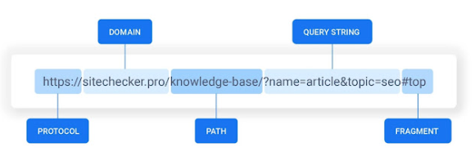
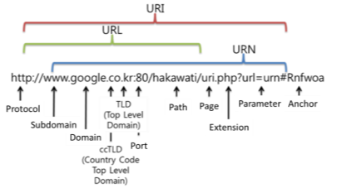
Relationship: URL/URN, URI, IRI
Structure of the URL:
URL: Uniform Resource Locator
URN: Universal Resource Names
URI: Uniform Resource Identifier
IRI: Internationalized Resource Identifier

Slide 17
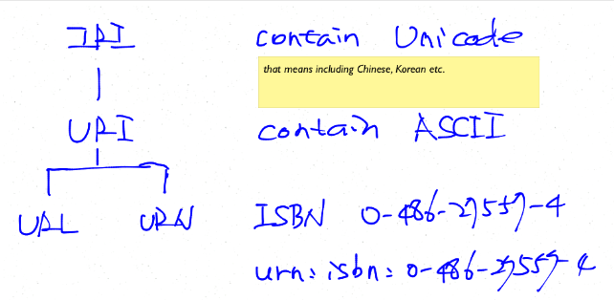
Data Story: IRI, URI, URL and URN
URL: Uniform Resource Locator, usually using specific protocols to locate resource within World Wide Web is the most common type of URI.
URN: Universal Resource Names, one of the URI type with urn:scheme and the typical use example is ISBN system.
URI: Uniform Resource Identifier, includes URL and URN.
IRI: Internationalized Resource Identifier, compare to URI, it's characters are Unicode which means including Chinese, Japanese and Koreans etc.
Source: https://parklize.blogspot.com/2014/05/iri-uri-url-and-urn.html

Slide 18
02- The Semantic Web, RDF, Linked Data (& SPARQL)
011
02.03 Resource Description Framework (RDF) - 1

Slide 19
02- The Semantic Web, RDF, Linked Data (& SPARQL)
012
02.03 Resource Description Framework (RDF) - 2

Slide 20
02- The Semantic Web, RDF, Linked Data (& SPARQL)
013
02.03 RDF – 3 – Data Typing

Slide 21
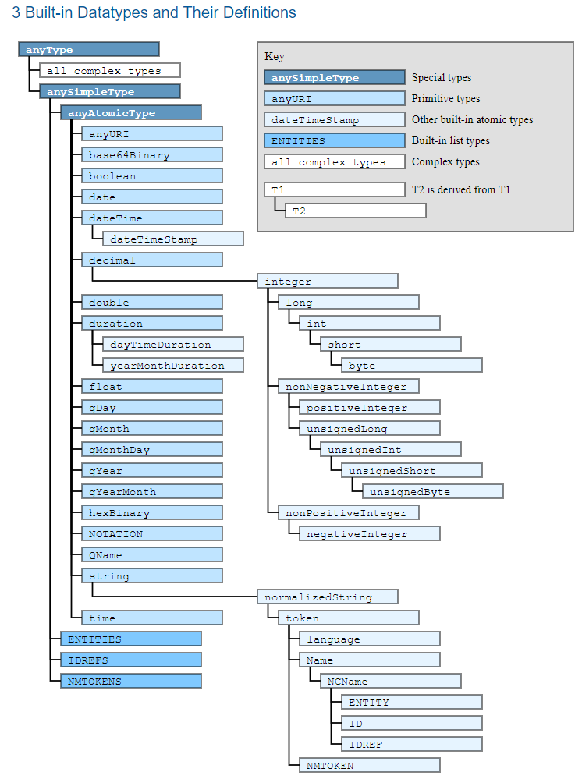
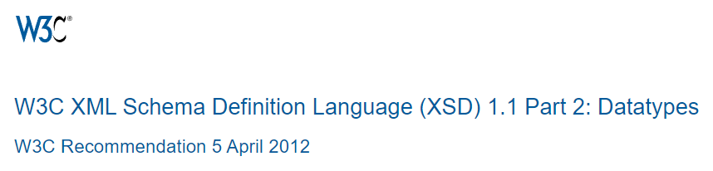
Triple in RDF
Subject (URI)
Predicate (URI)
Object (URI)
Object (Literals)
String
Integer
Date
…

Slide 22
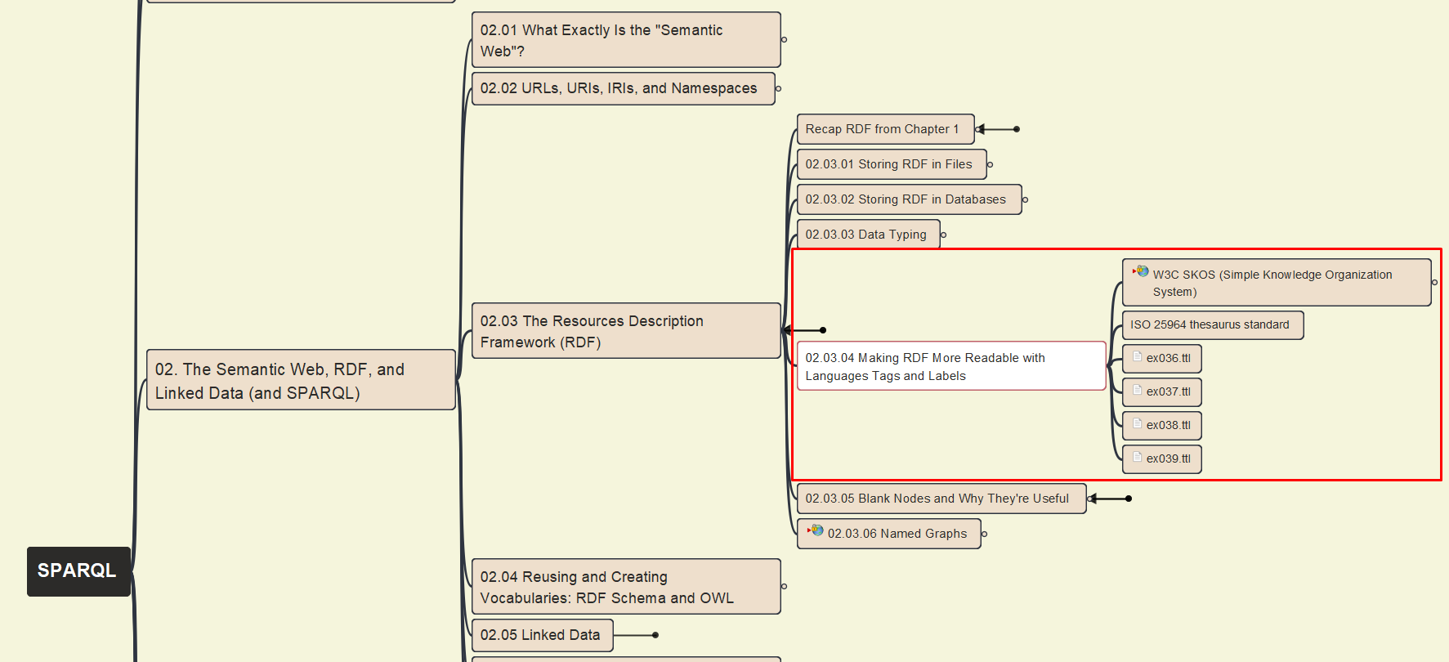

02- The Semantic Web, RDF, Linked Data (& SPARQL)
014
02.03 RDF – 4 – Making RDF More Readable with Language Tags and Labels

Slide 23
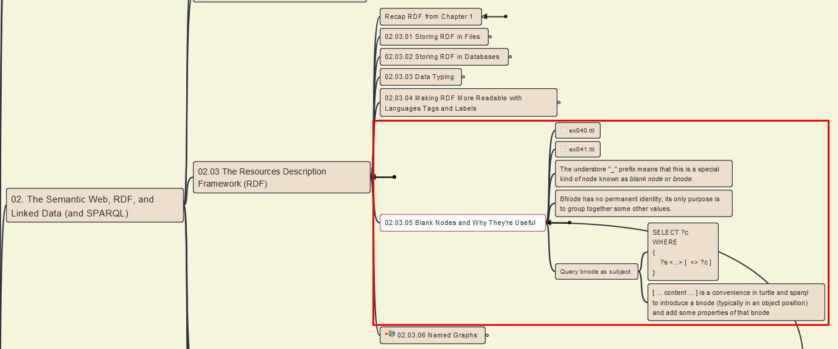
02- The Semantic Web, RDF, Linked Data (& SPARQL)
015
02.03 RDF – 5 – Blank Nodes and Why They're Useful

Slide 24
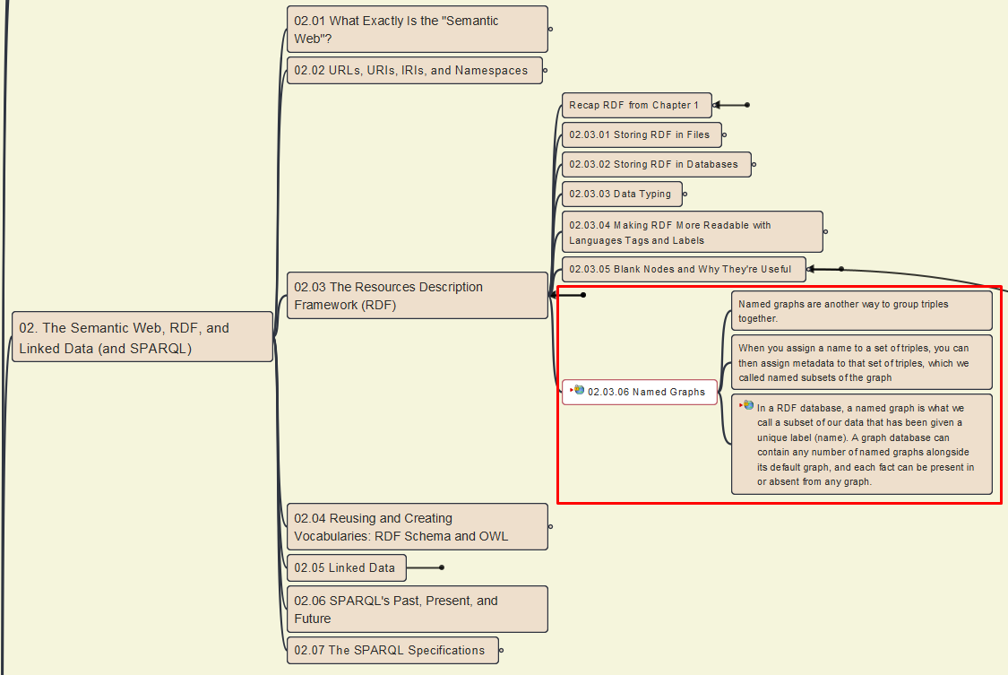
02- The Semantic Web, RDF, Linked Data (& SPARQL)
016
02.03 RDF –
6 – Named Graphs

Slide 25
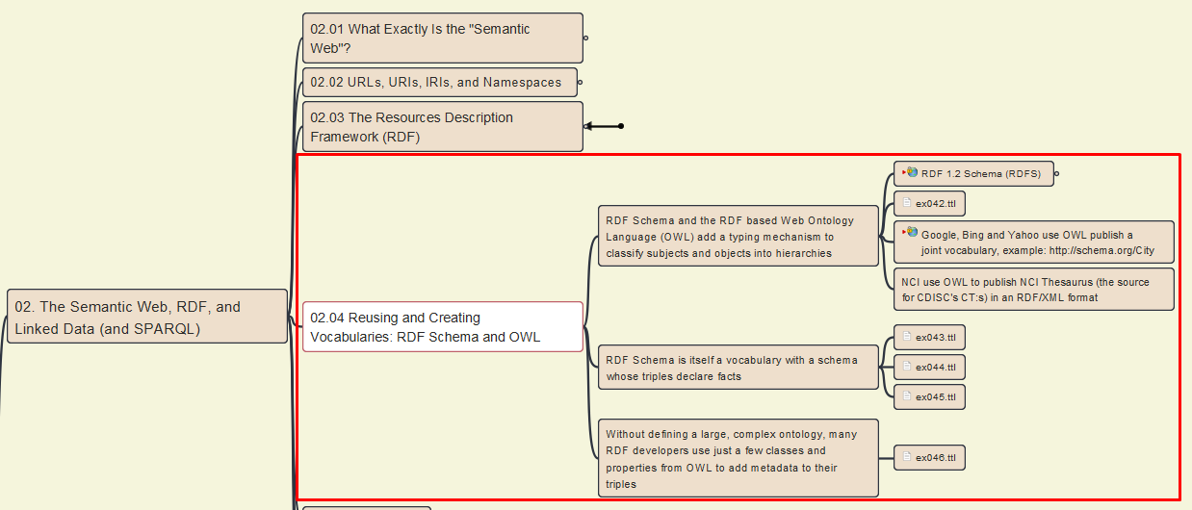
02- The Semantic Web, RDF, Linked Data (& SPARQL)
016
02.04 Reusing and Creating Vocabularies

Slide 26
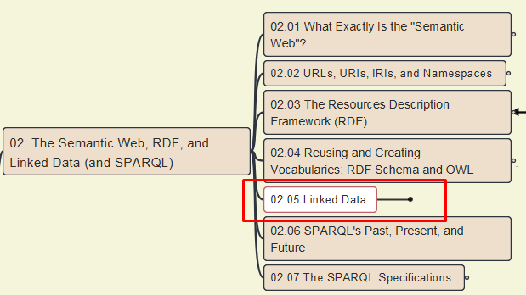
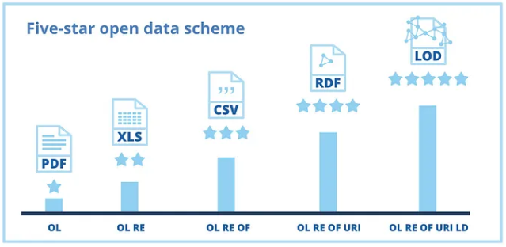
02- The Semantic Web, RDF, Linked Data (& SPARQL)
018
02.05 Linked Data

Slide 27
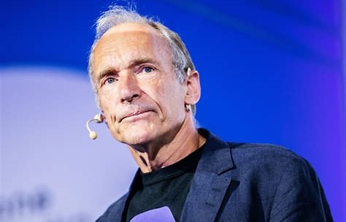
Four Principles of Linked Data
1. Use URIs as names for things
2. Use HTTP URIs so that people can look up those names
3. When someone looks up a URI, provide useful information, using the standards (RDF, SPARQL)
4. Include links to other URIs so that they can discover more things
Five-Star Linked Open Data
: any kind of data sharing at all
✪  : sharing data in a machine-readable format
✪   : sharing data on the Web using a nonproprietary format
✪    : putting data in a linked data format, in which concepts were identified by URLs so that we could more easily cross-reference them with other data
✪    : a government connects the data to other data, by providing links to related data

Slide 28
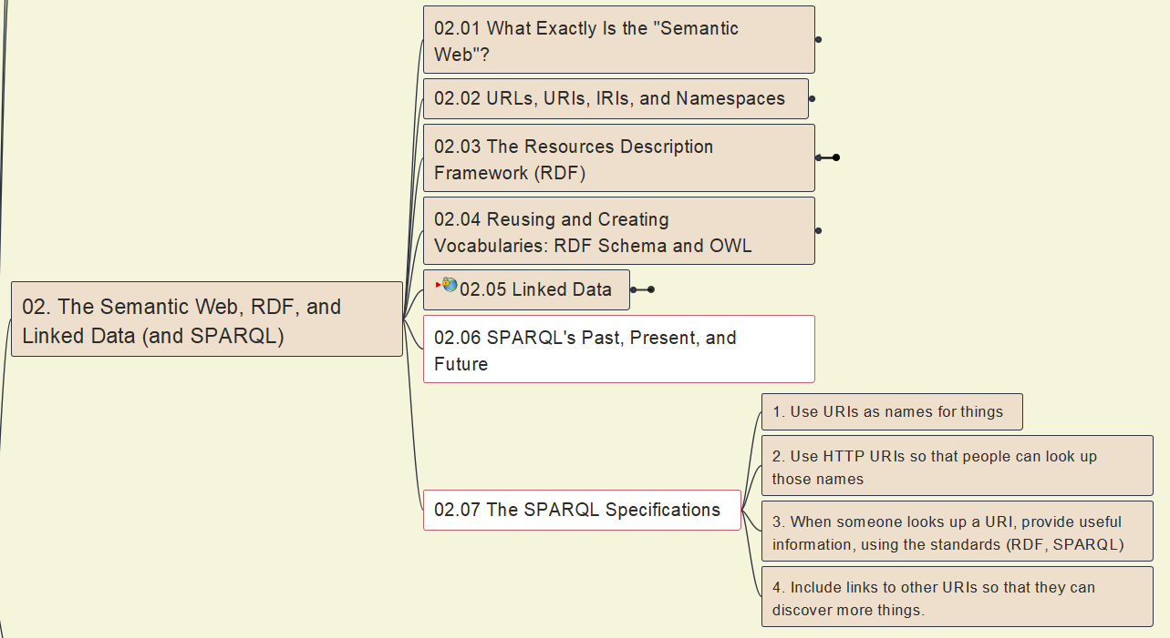
02- The Semantic Web, RDF, Linked Data (& SPARQL)
019
02.06 SPARQL Evolution
02.07 SPARQL Specifications

Slide 29
SPARQL’s Past, Present and Future
1999, RDF became a standard
By 2004, over a dozen query language had been developed
2004, W3C formed the RDF Data Access Working Group (DAWG)
Late 2004, RDF-DAWG released 1st draft of the SPARQL Query Language specification
Early 2008, the query language, protocol, and query results XML format became Recommendations, or official W3C specifications
2008, SPARQL implementations existed (Triplestores, ARQ), SPARQL endpoints appeared
2009, RDF-DAWG’s charter expired, W3C created SPARQL Working Group
Late 2009, SPARQL Working Group released 1st Working Drafts of the SPARQL 1.1 specifications
March 2013, SPARQL 1.1 specification became W3C Recommendations
End of 2012, SPARQL-WG completed work including several new specifications
Aug 2024, W3C Working Draft of SPARQL 1.2 released

Slide 30

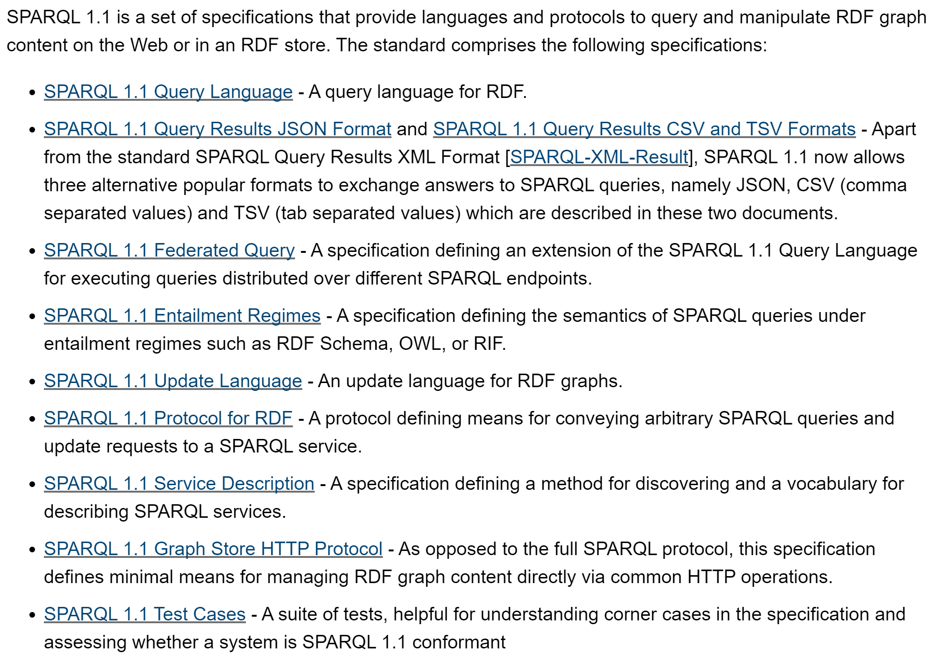
The SPARQL 1.1 Specification
SPARQL 1.2 Overview

Slide 31
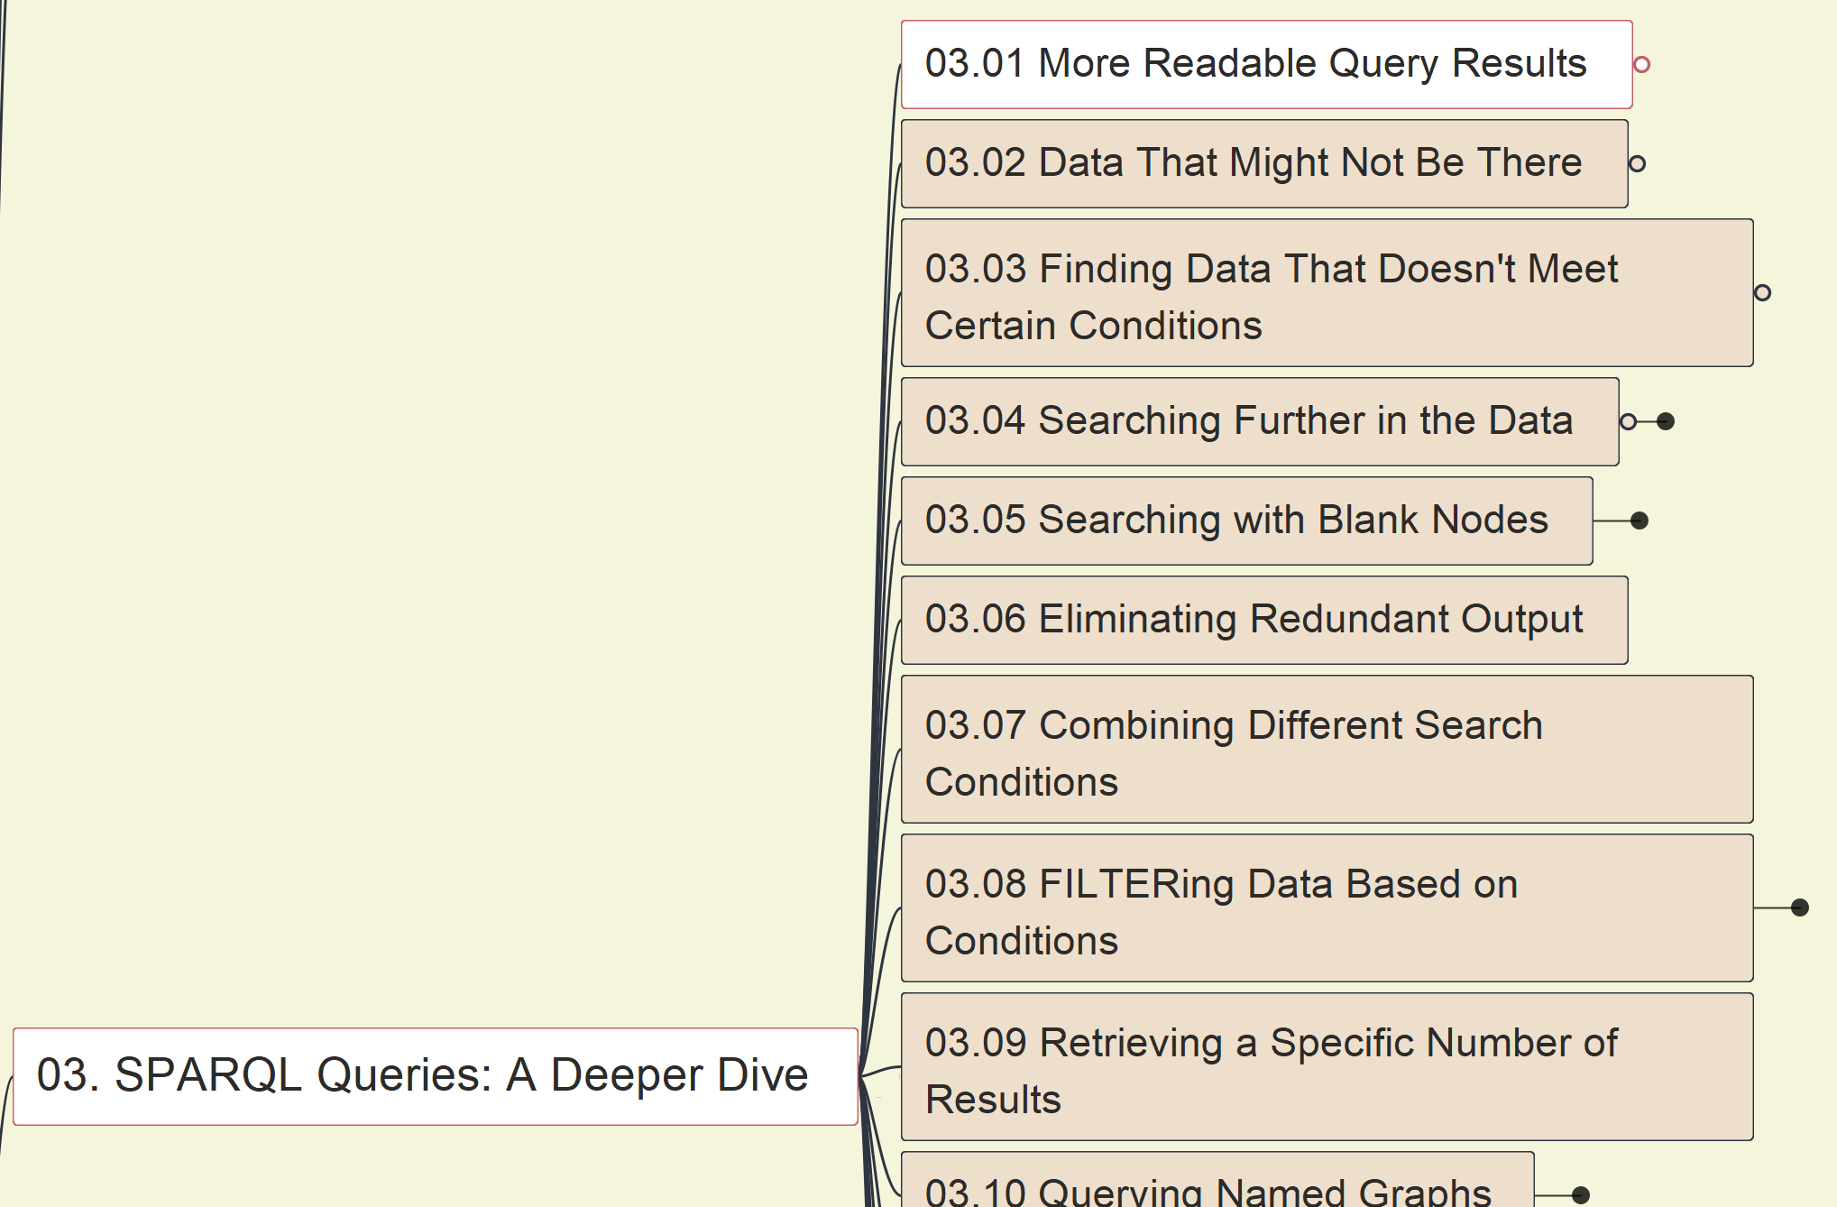
03 - SPARQL Queries: A Deeper Dive
020
03.01 More Readable Query Results

Slide 32
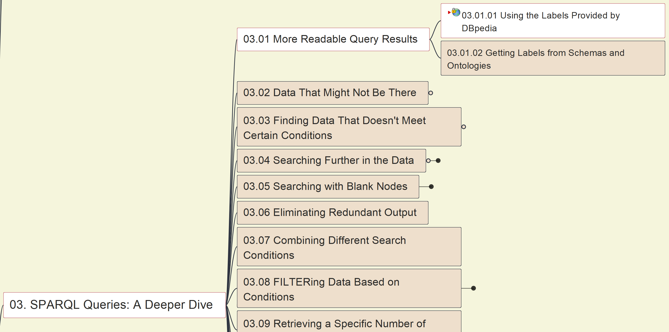
03 - SPARQL Queries: A Deeper Dive
021
03.01 More Readable Query Results
03.01.01 Using Labels by DBpedia

Slide 33
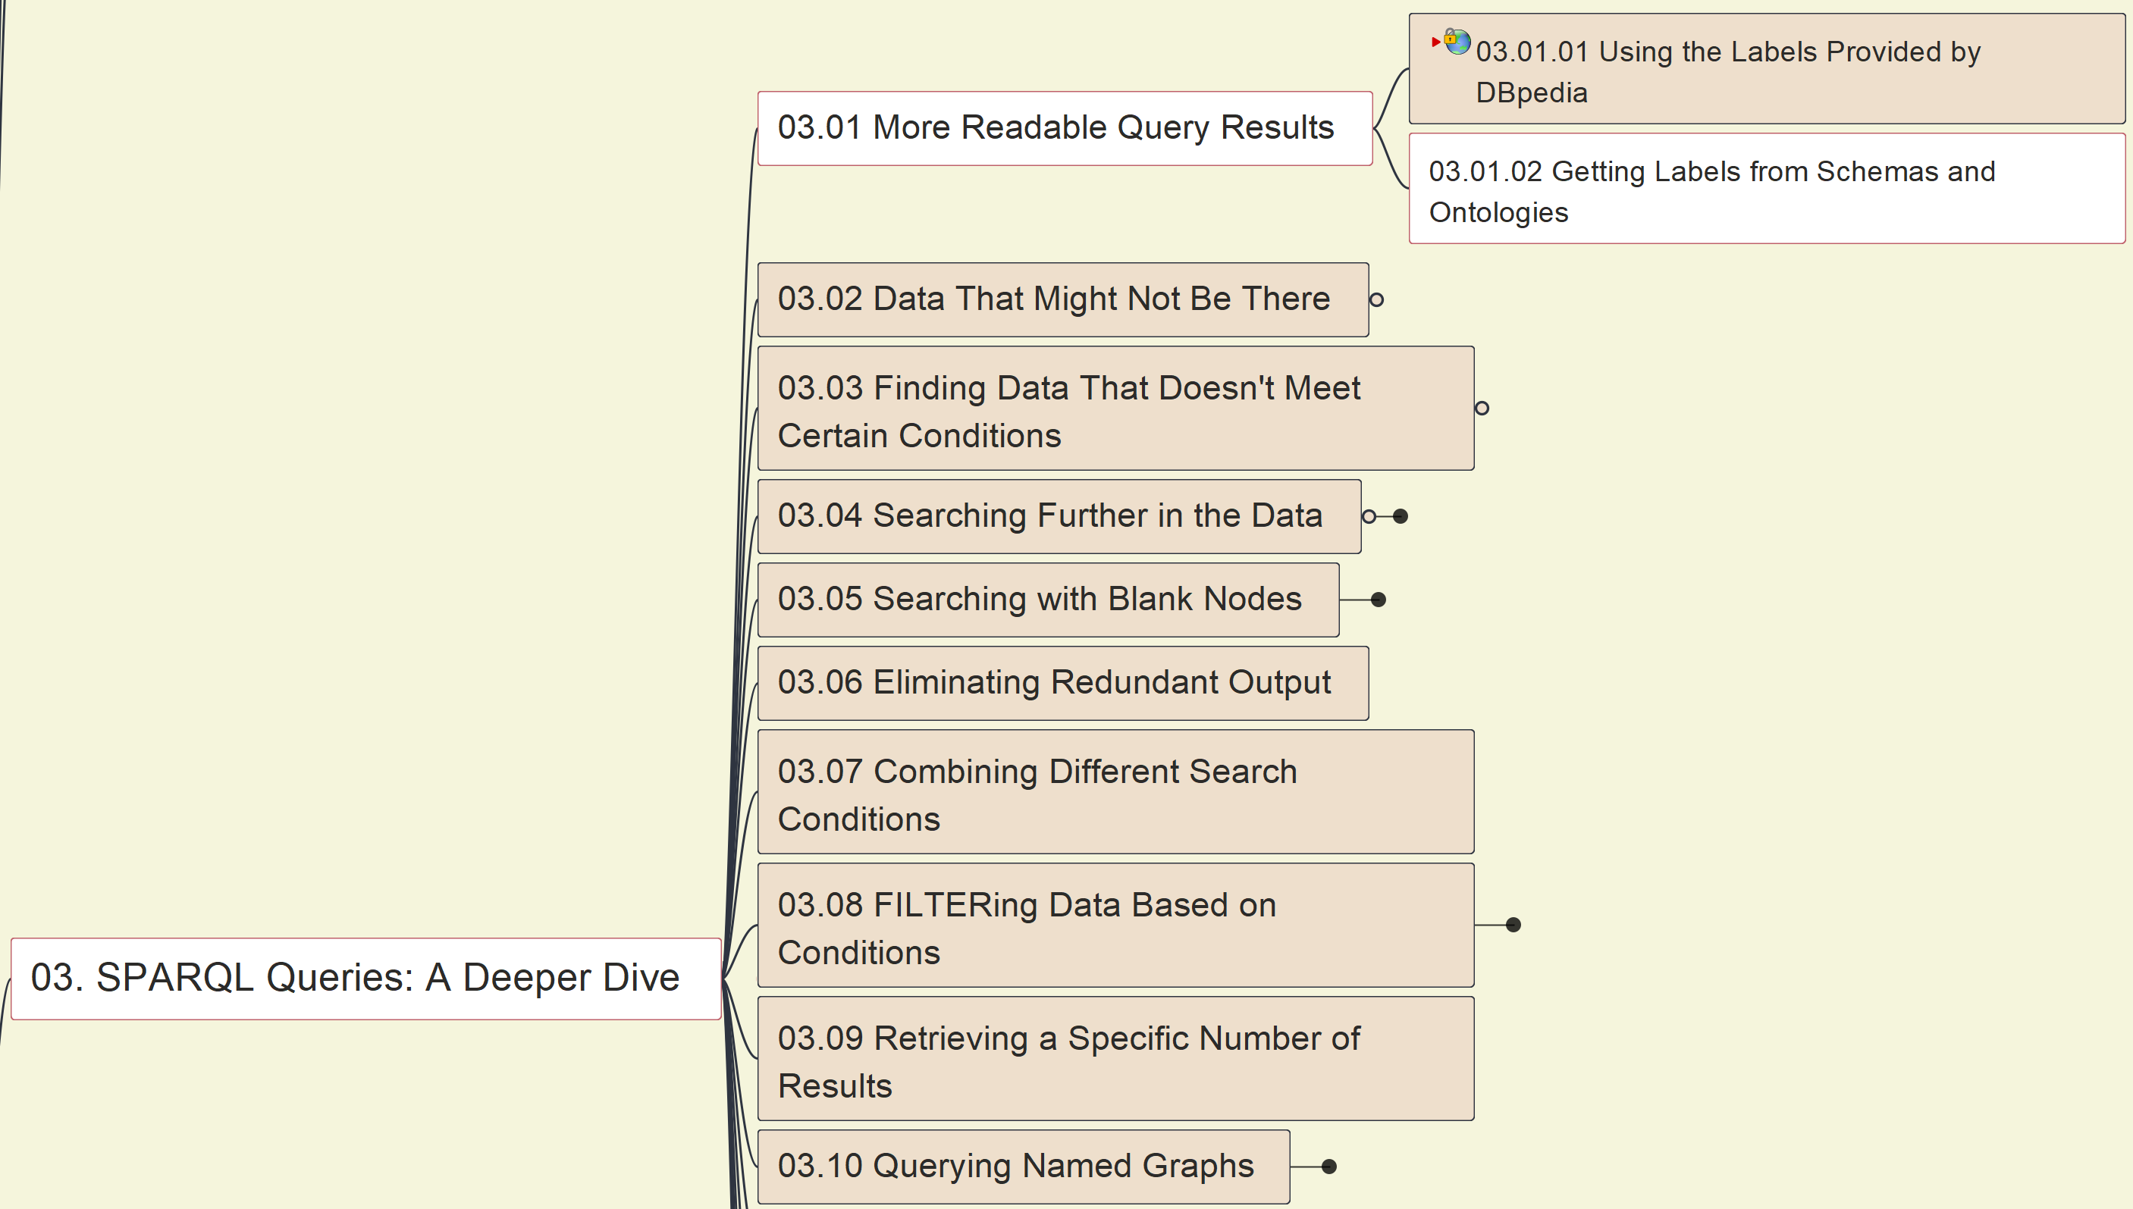
03 - SPARQL Queries: A Deeper Dive
022
03.01 More Readable Query Results
03.01.02 Getting Labels from Schemas & Ontologies

Slide 34
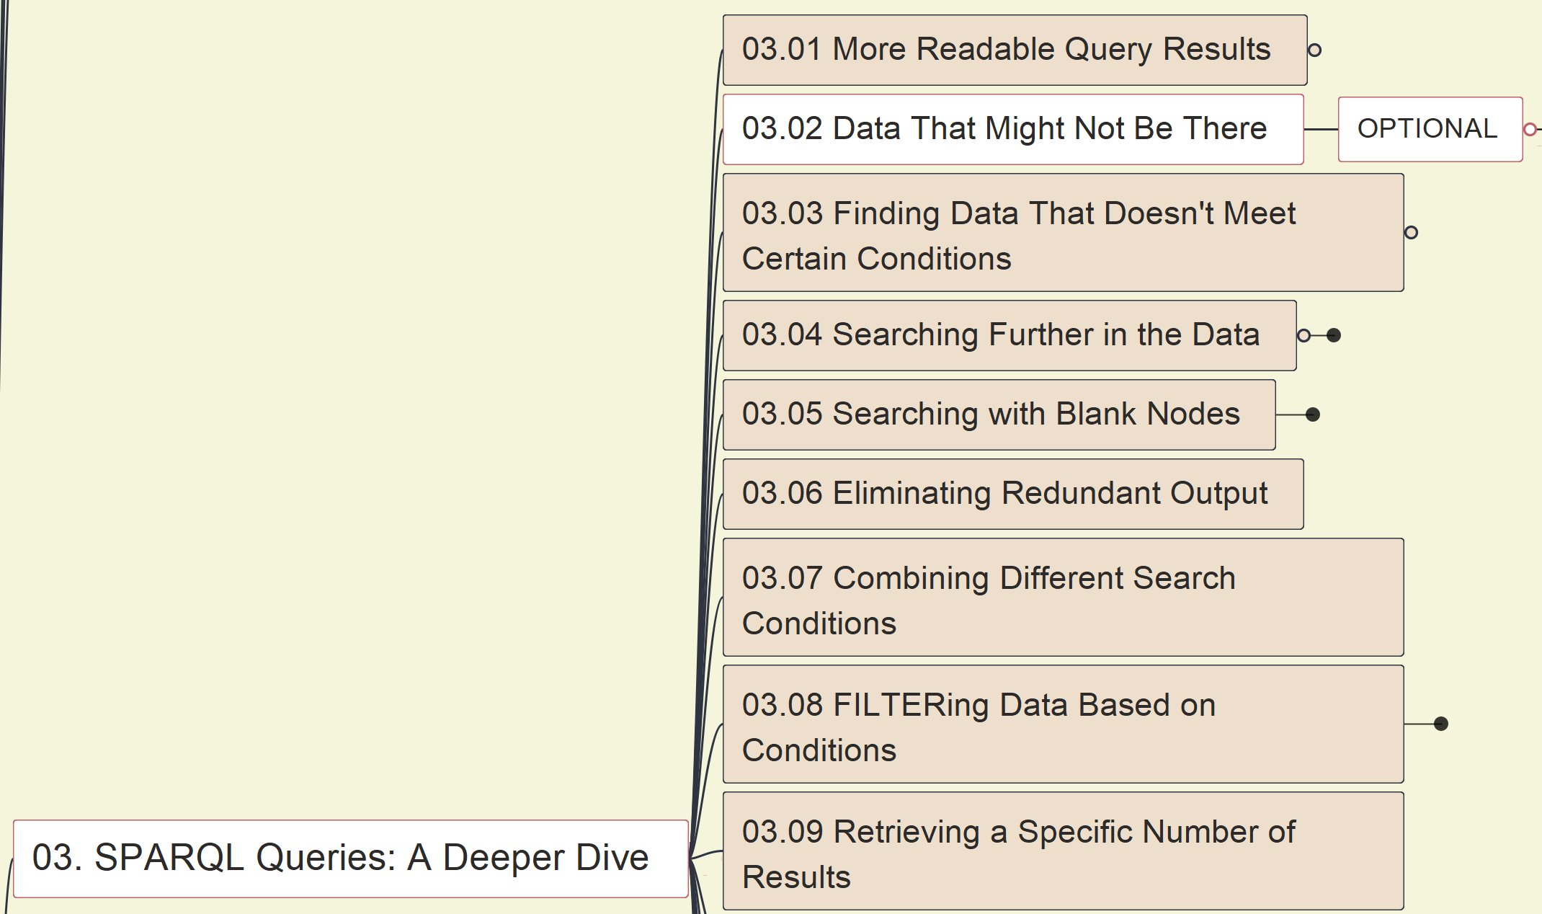
03 - SPARQL Queries: A Deeper Dive
023
03.02 Data That Might Not Be There – OPTIONAL
(page 55)

Slide 35
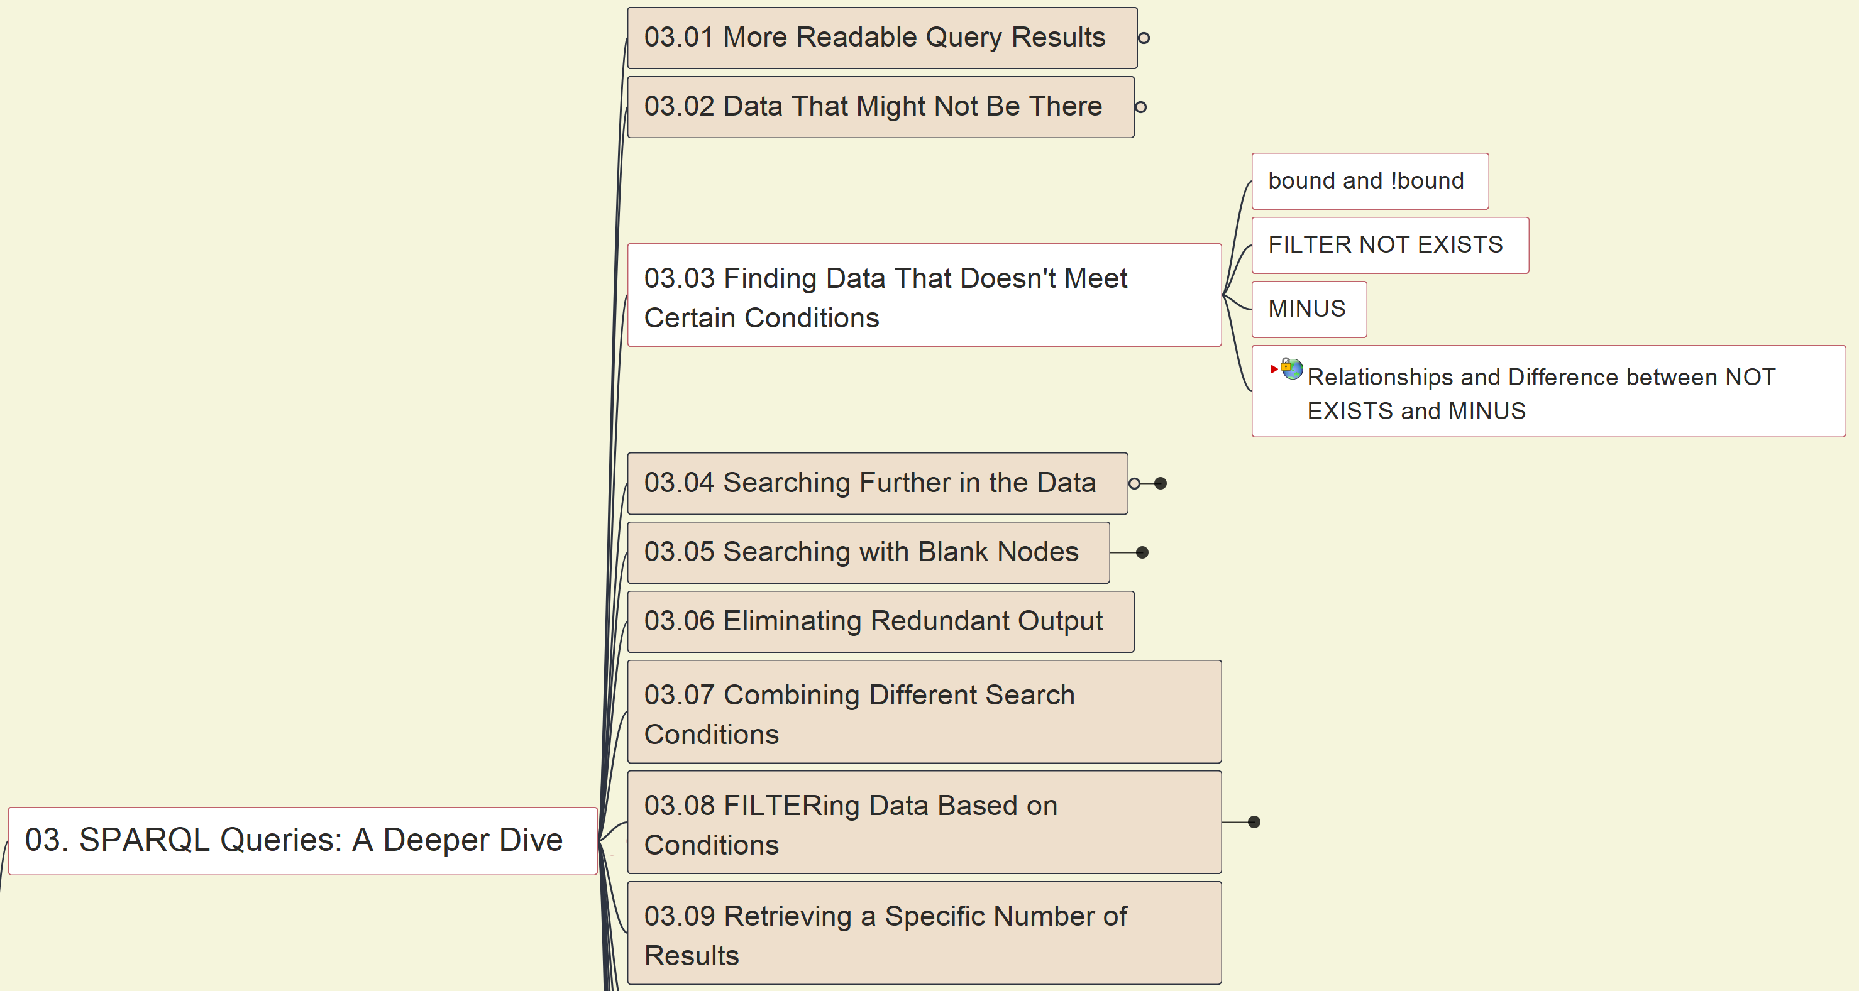
03 - SPARQL Queries: A Deeper Dive
024
03.03 Finding Data That Doesn’t Meet Certain Conditions (page 59)

Slide 36
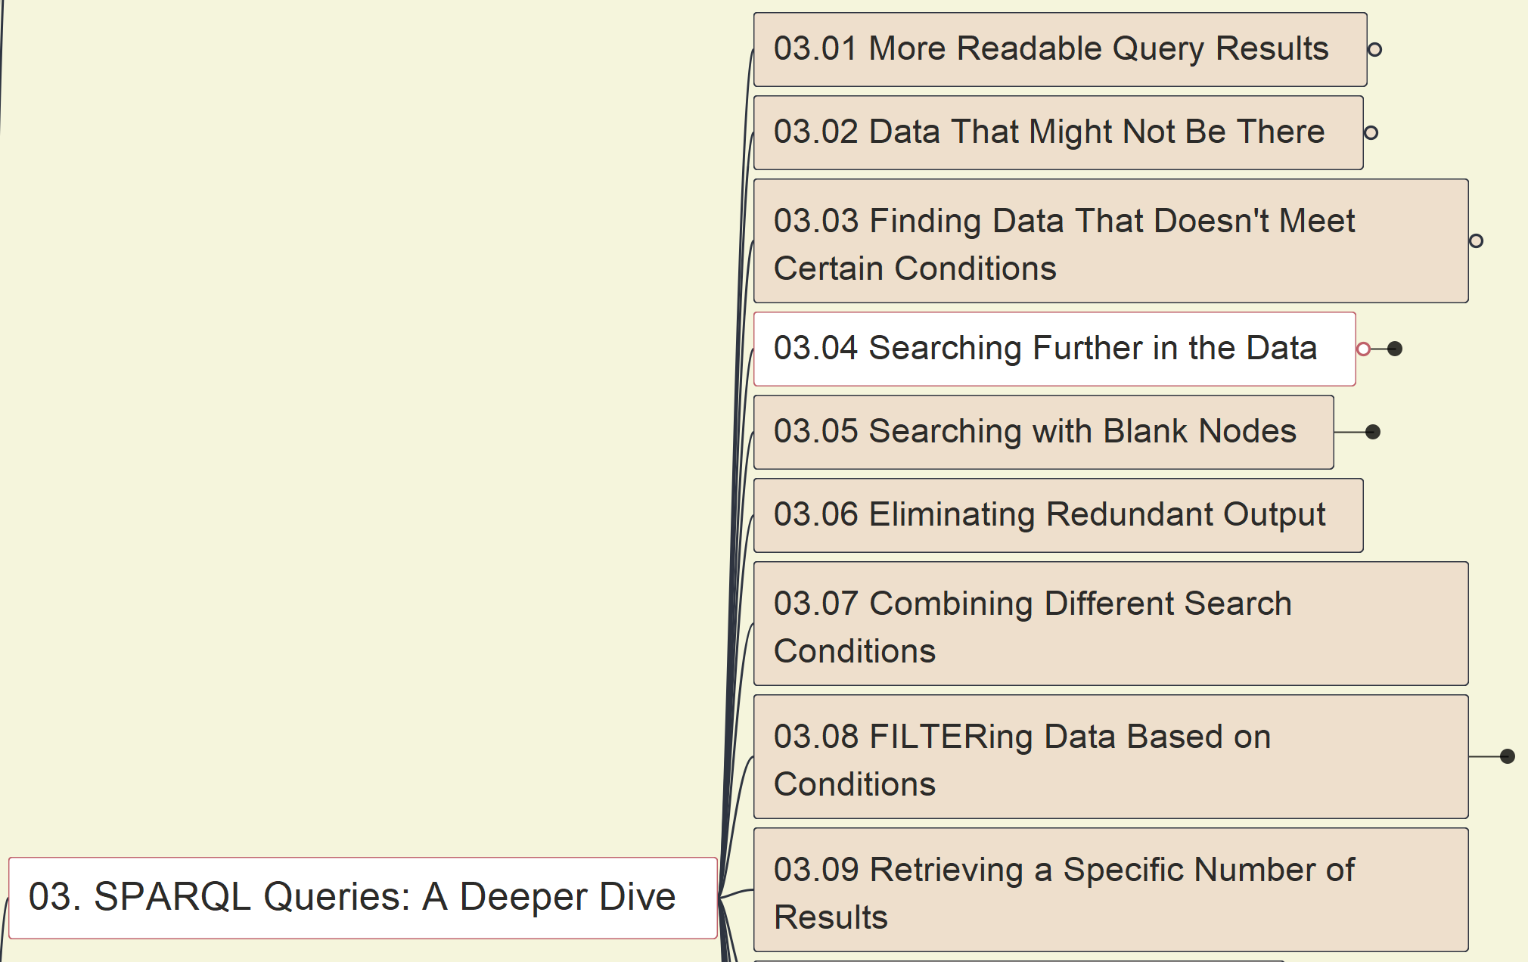
03 - SPARQL Queries: A Deeper Dive
025
03.04 Searching Further in the Data
(1) Query from multiple tables or files

Slide 37
03 - SPARQL Queries: A Deeper Dive
026
03.04 Searching Further in the Data
(2) Query via Property Path

Slide 38
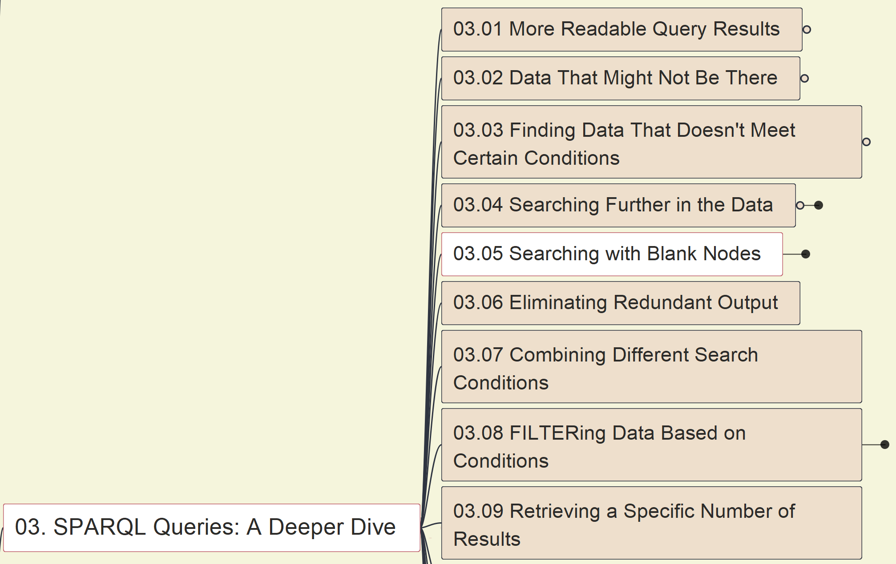
03 - SPARQL Queries: A Deeper Dive
027
03.05 Searching with Blank Nodes

Slide 39
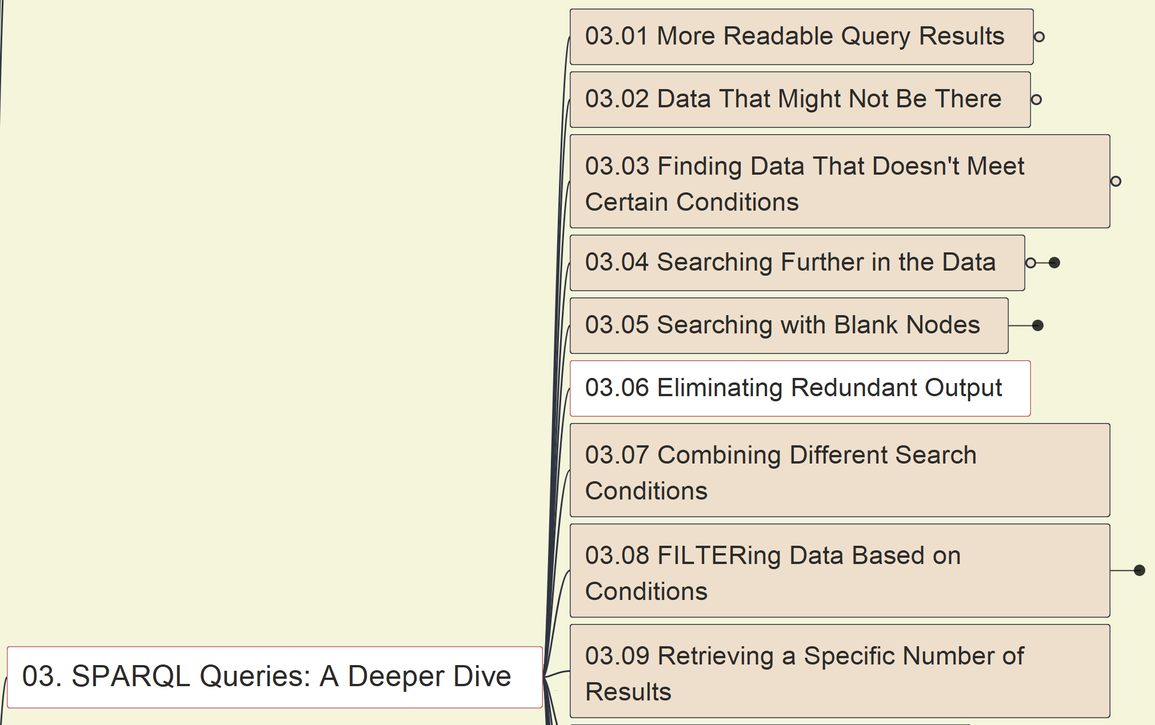
03 - SPARQL Queries: A Deeper Dive
028
03.06 Eliminating Redundant Output
- DISTINCT

Slide 40
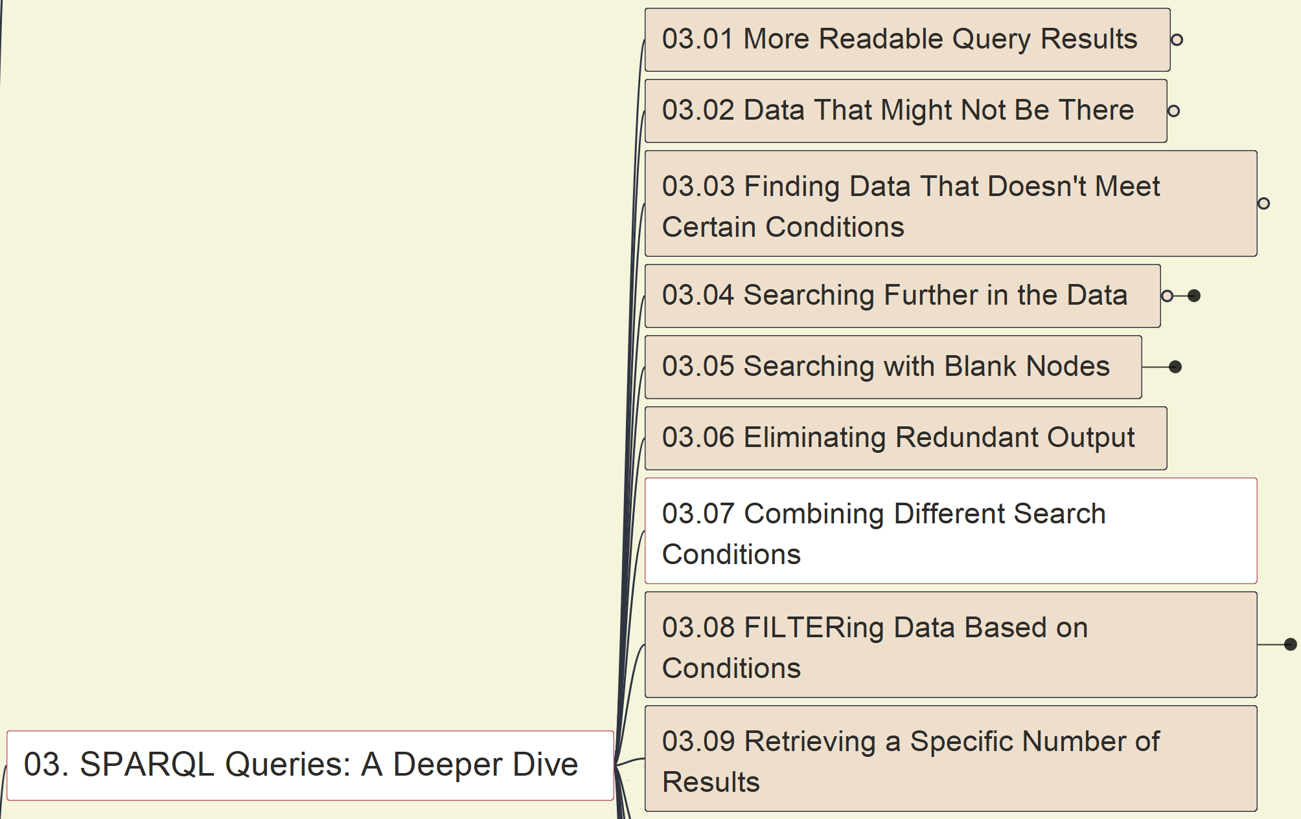
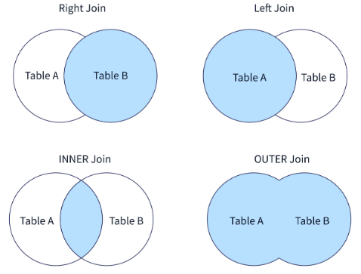
03 - SPARQL Queries: A Deeper Dive
029
03.07 Combining Different Search Conditions
- UNION

Slide 41
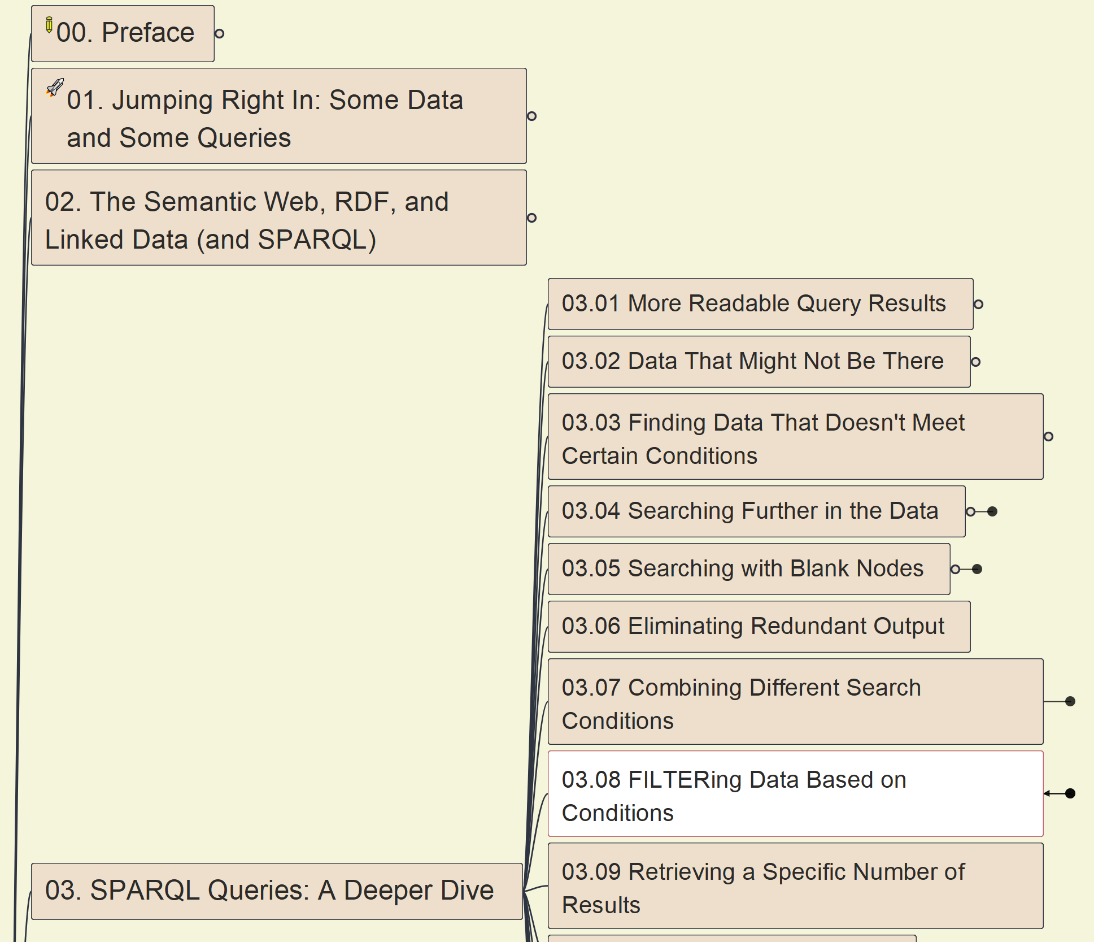
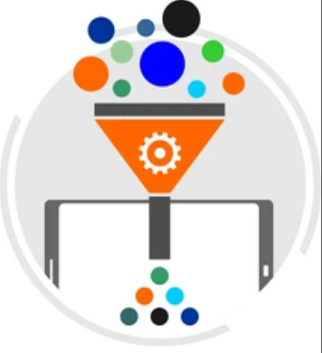
03 - SPARQL Queries: A Deeper Dive
030
03.08 FILTERing Data Based on Conditions

Slide 42
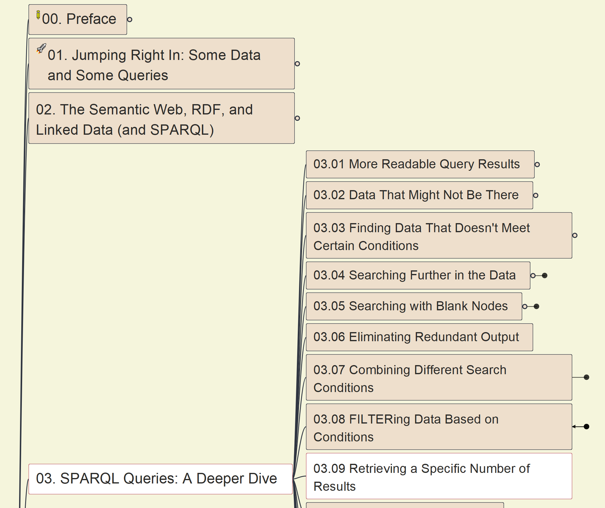
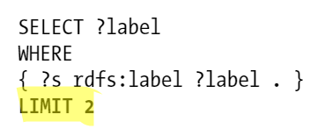
03 - SPARQL Queries: A Deeper Dive
031
03.09 Retrieving a Specific Number of Results
-- LIMIT

Slide 43
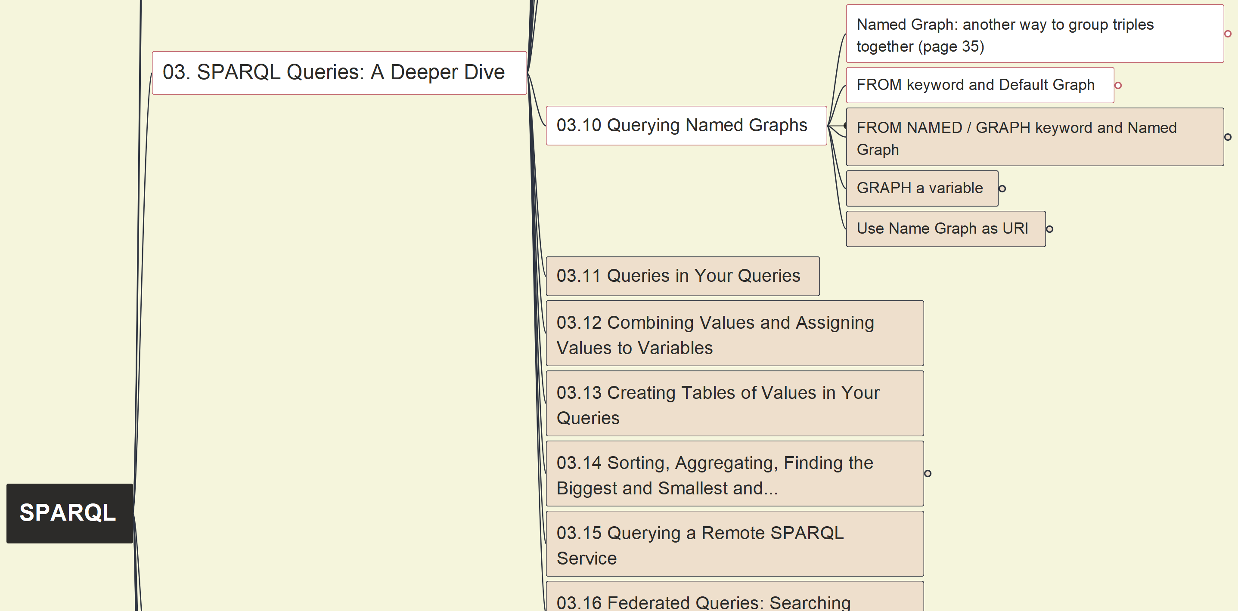
03 - SPARQL Queries: A Deeper Dive
032
03.10 Querying Name Graphs
(1) FROM

Slide 44
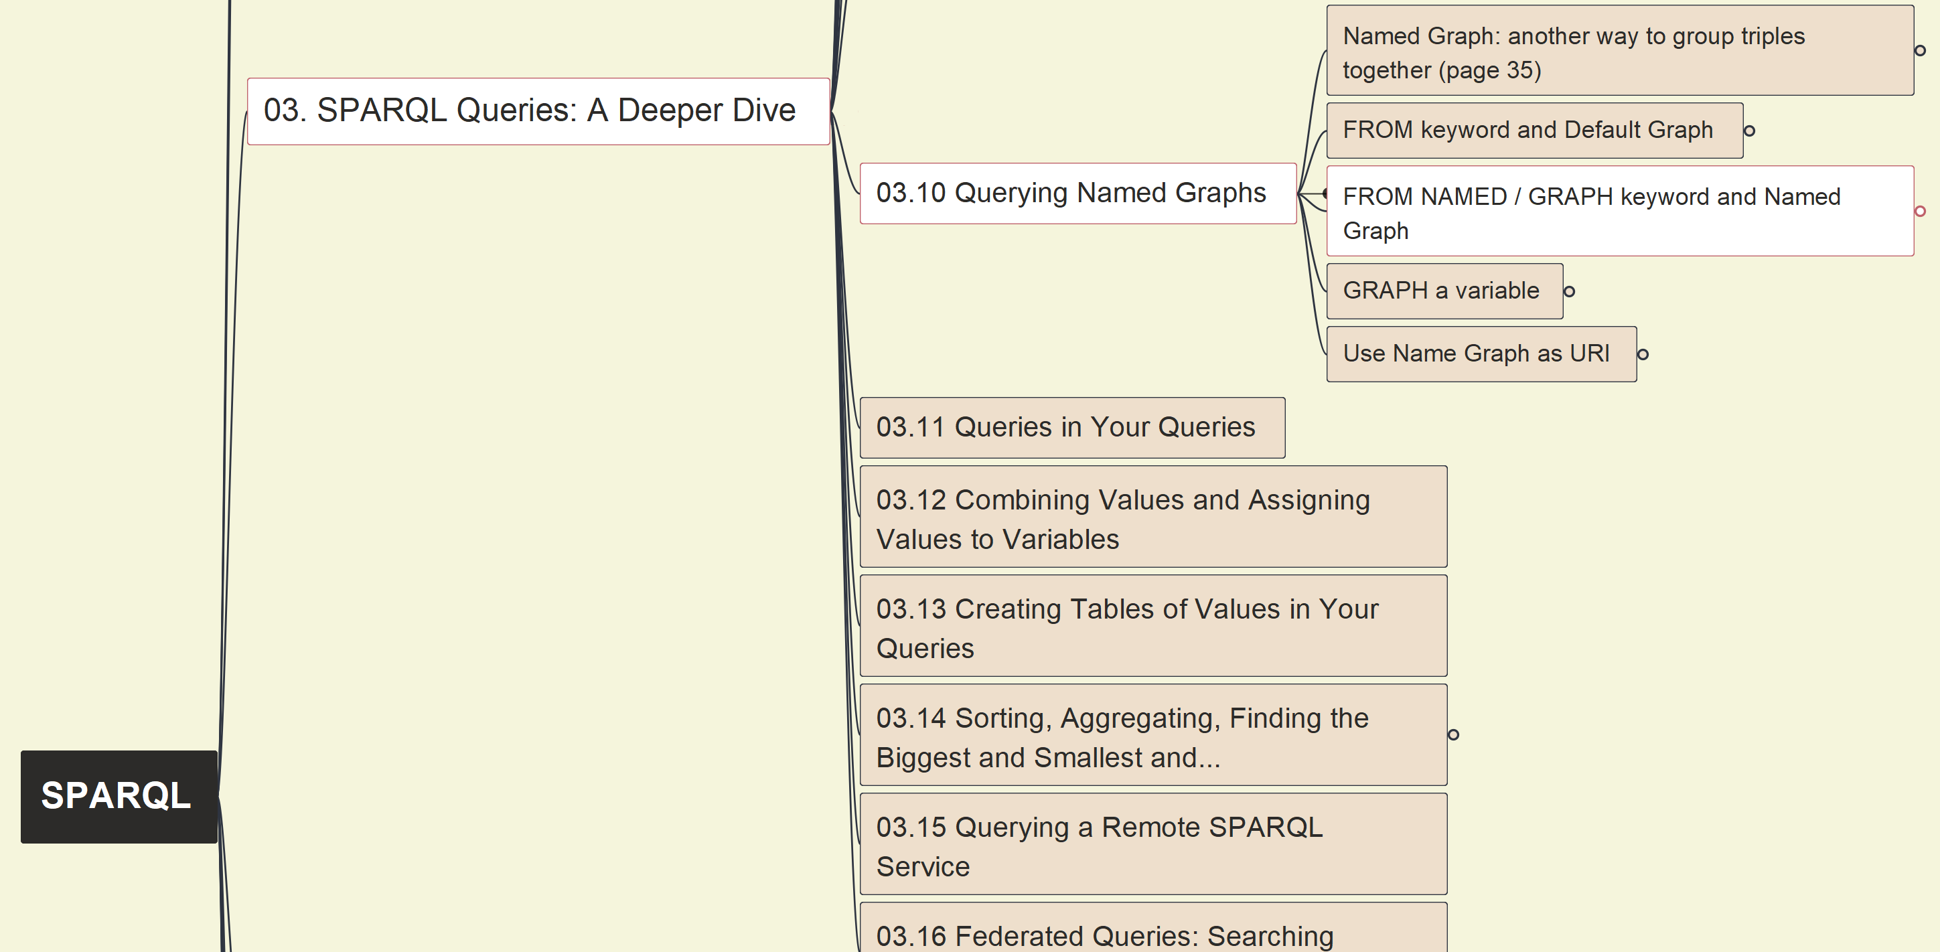
03 - SPARQL Queries: A Deeper Dive
033
03.10 Querying Name Graphs
(2) FROM NAMED + GRAPH

Slide 45
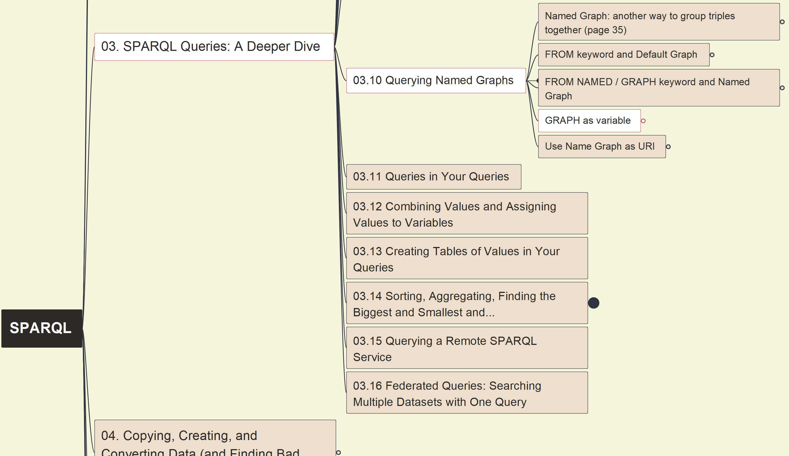
03 - SPARQL Queries: A Deeper Dive
034
03.10 Querying Name Graphs
(3) GRAPH as variable

Slide 46
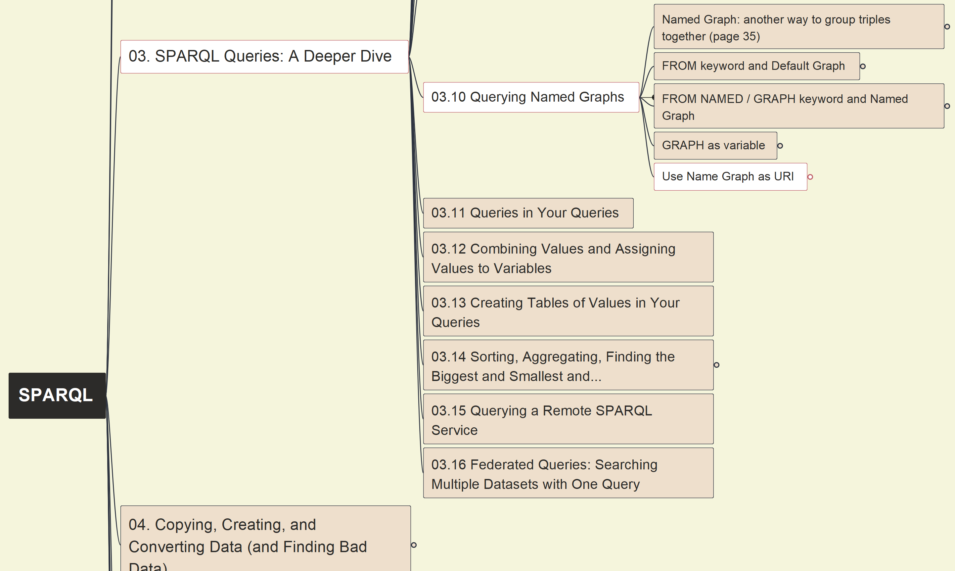
03 - SPARQL Queries: A Deeper Dive
035
03.10 Querying Name Graphs
(4) Graph as URI

Slide 47
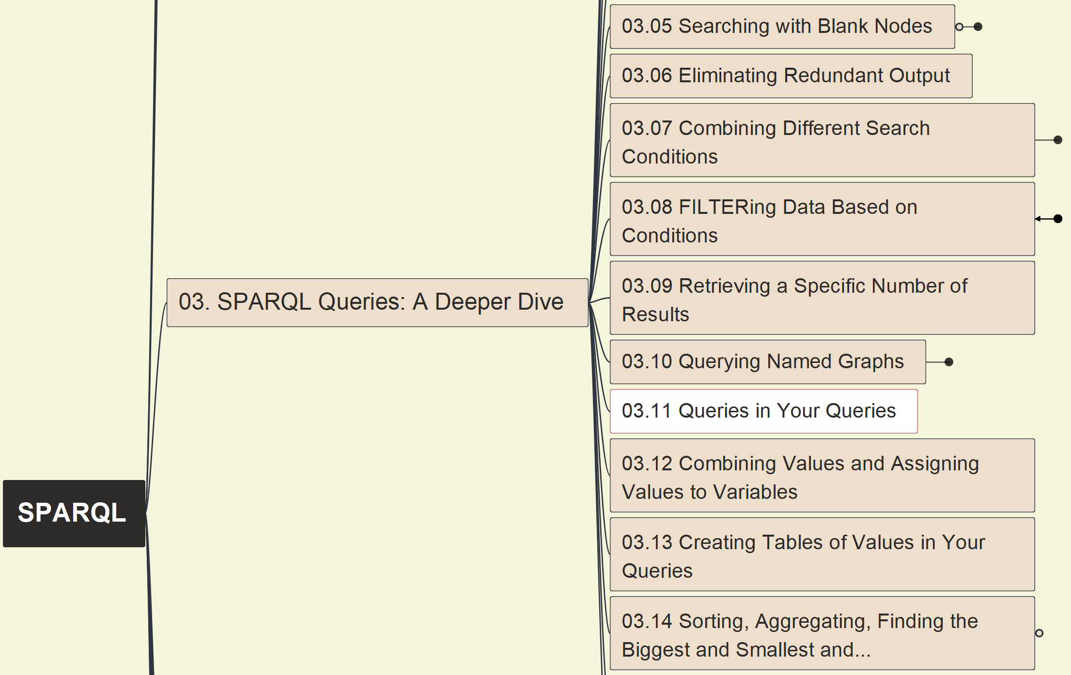

03 - SPARQL Queries: A Deeper Dive
036
03.11 Queries in Your Queries

Slide 48
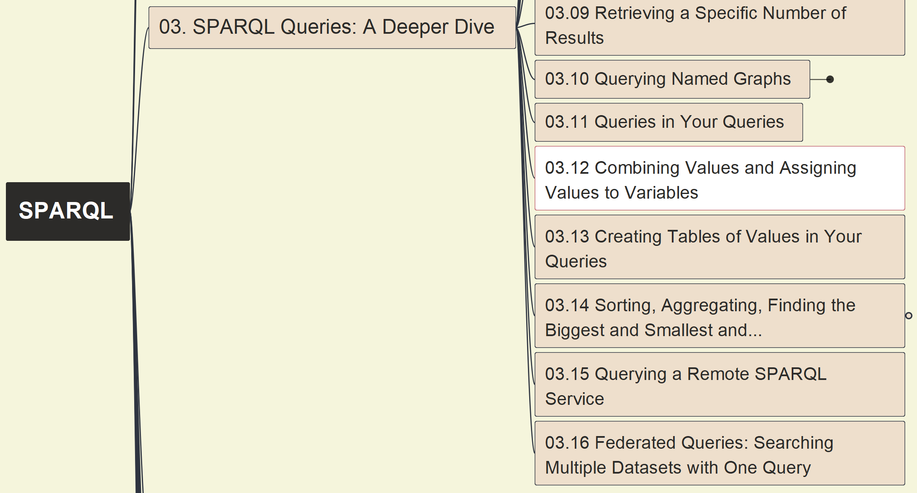
03 - SPARQL Queries: A Deeper Dive
037
03.12 Combining Values and Assigning Values to Variables

Slide 49
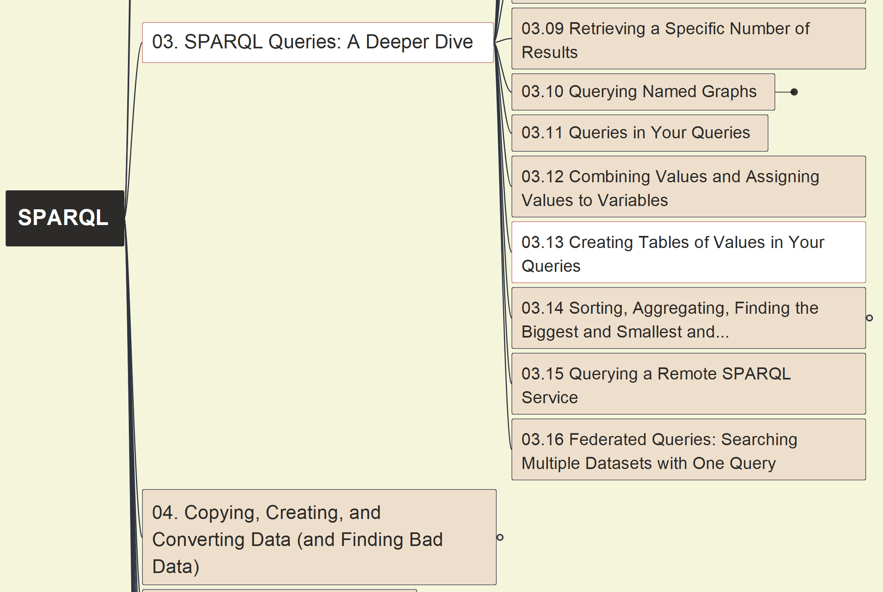
03 - SPARQL Queries: A Deeper Dive
038
03.13 Creating Tables of Values in Your Queries

Slide 50
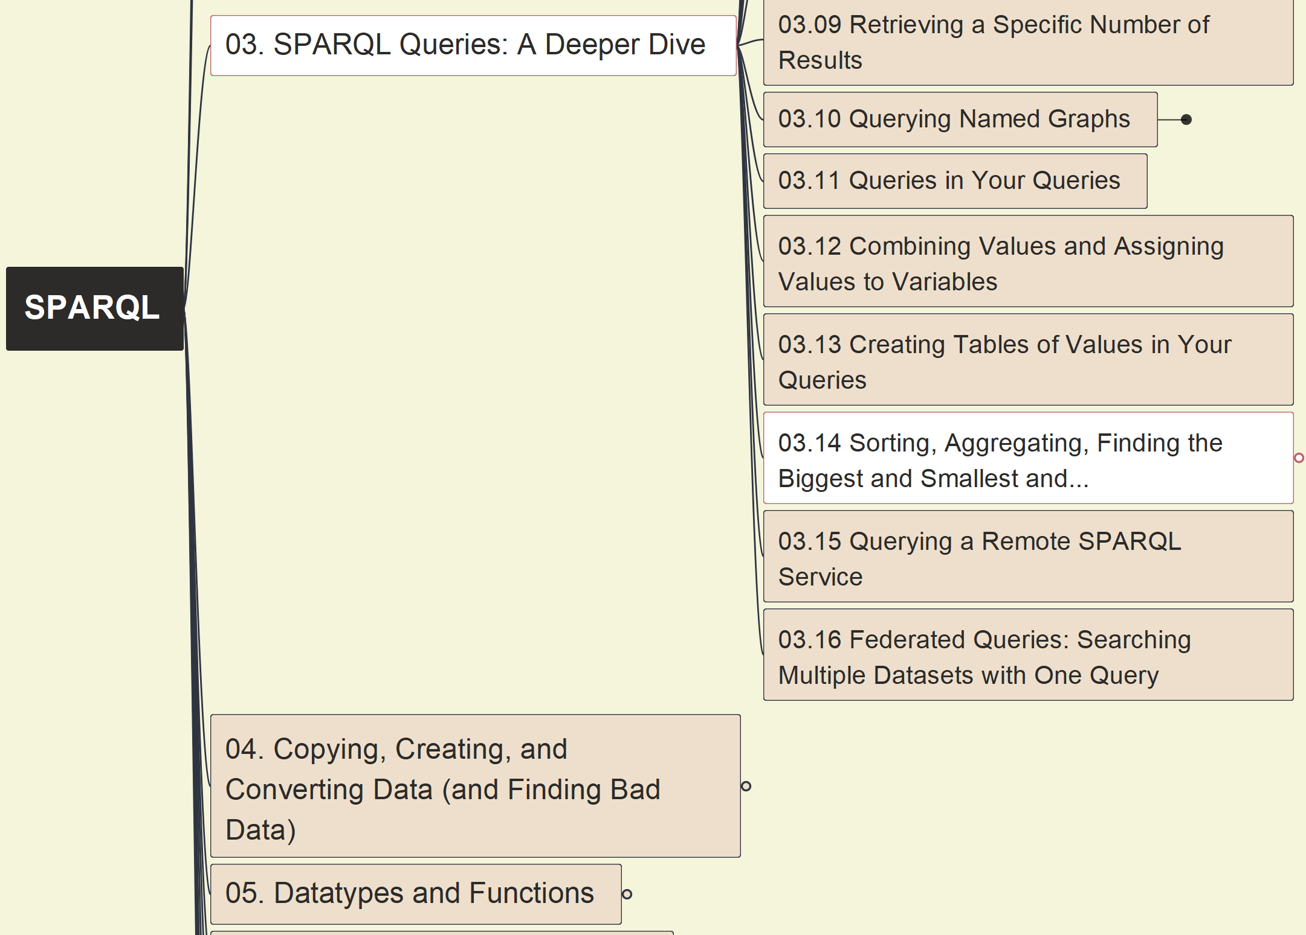
03 - SPARQL Queries: A Deeper Dive
039
03.14 Sorting, Aggregating, Finding the Biggest and Smallest and…
(1) Sorting Data

Slide 51
03 - SPARQL Queries: A Deeper Dive
040
03.14 Sorting, Aggregating, Finding the Biggest and Smallest and…
(2) MIN(), MAX(), AVG(), SUM(), COUNT()

Slide 52
03 - SPARQL Queries: A Deeper Dive
041
03.14 Sorting, Aggregating, Finding the Biggest and Smallest and…
(3) GROUP BY, HAVING

Slide 53
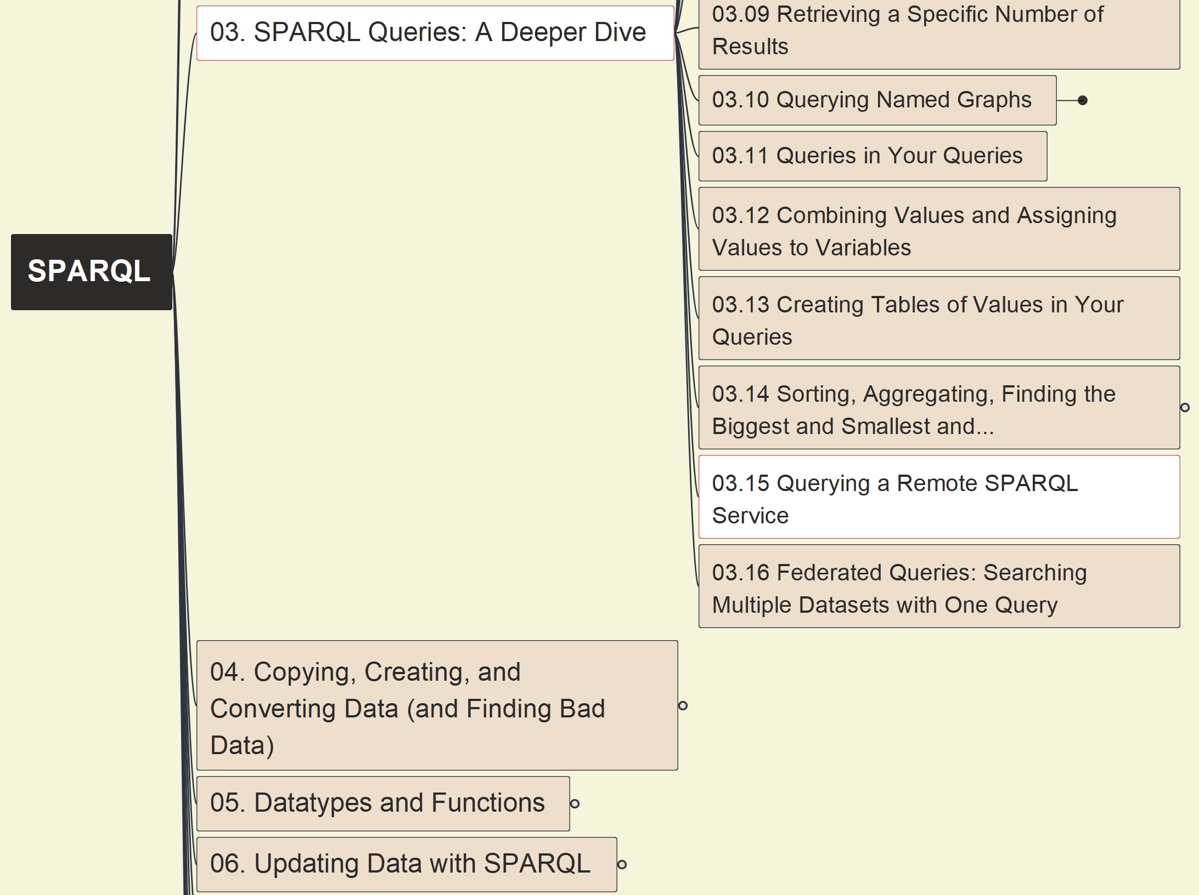
03 - SPARQL Queries: A Deeper Dive
042
03.15 Querying a Remote SPARQL Service

Slide 54

03 - SPARQL Queries: A Deeper Dive
043
03.16 Federated Queries: Searching Multiple Datasets with One Query

Slide 55

04 – Copying, Creating, and Converting Data (and Finding Bad Data)
044
4.1 Query Forms: SELECT, DESCRIBE, ASK, and CONSTRUCT

Slide 56

04 – Copying, Creating, and Converting Data (and Finding Bad Data)
045
4.2 Copying Data

Slide 57

04 – Copying, Creating, and Converting Data (and Finding Bad Data)
046
4.3 Creating New Data

Slide 58

04 – Copying, Creating, and Converting Data (and Finding Bad Data)
047
4.4 Converting Data

Slide 59

04 – Copying, Creating, and Converting Data (and Finding Bad Data)
048
4.5 Finding Bad Data
(1) Defining Rules with SPARQL

Slide 60
04 – Copying, Creating, and Converting Data (and Finding Bad Data)
049
4.5 Finding Bad Data
(2) Generating Data About Broken Rules

Slide 61
04 – Copying, Creating, and Converting Data (and Finding Bad Data)
050
4.5 Finding Bad Data
(3) Using Existing SPARQL Rules Vocabularies

Slide 62

04 – Copying, Creating, and Converting Data (and Finding Bad Data)
051
4.6 Asking for a Description of a Resource

Slide 63

05. Datatypes and Functions
052
5.1 Datatypes and Queries
Part 1: recap

Slide 64

05. Datatypes and Functions
053
5.1 Datatypes and Queries
Part 2: Representing Strings

Slide 65

05. Datatypes and Functions
054
5.1 Datatypes and Queries
Part 3: Comparing Values and Doing Arithmetic

Slide 66

05. Datatypes and Functions 05.02 Functions
055
5.2.1 Program Logic Functions
(1) IF()

Slide 67

05. Datatypes and Functions 05.02 Functions
056
5.2.1 Program Logic Functions
(2) COALESCE()

Slide 68

05. Datatypes and Functions 05.02 Functions
057
5.2.2 Node Type and Datatype Checking Functions

Slide 69

05. Datatypes and Functions 05.02 Functions
058
5.2.3 Node Type Conversion
(1) URI() and ENCODE_FOR_URI()

Slide 70

05. Datatypes and Functions 05.02 Functions
059
5.2.3 Node Type Conversion
(2) str()

Slide 71

05. Datatypes and Functions 05.02 Functions
060
5.2.4 Datatype Conversion
(1) Converting Functions

Slide 72

05. Datatypes and Functions 05.02 Functions
061
5.2.4 Datatype Conversion
(2) STRDT()

Slide 73

05. Datatypes and Functions 05.02 Functions
062
5.2.5 Checking, adding, and removing spoken language tags
(1) lang()

Slide 74

05. Datatypes and Functions 05.02 Functions
063
5.2.5 Checking, adding, and removing spoken language tags
(2) langMatches()

Slide 75

05. Datatypes and Functions 05.02 Functions
064
5.2.5 Checking, adding, and removing spoken language tags
(3) STRLANG()

Slide 76

05. Datatypes and Functions 05.02 Functions
065
5.2.6 String Functions

Slide 77

05. Datatypes and Functions 05.02 Functions
066
5.2.7 Numeric Functions

Slide 78

05. Datatypes and Functions 05.02 Functions
067
5.2.8 Data and Time Functions

Slide 79

05. Datatypes and Functions 05.02 Functions
068
5.2.9 Hash Functions

Slide 80

05. Datatypes and Functions 05.03 Extension Functions
069

Slide 81

06 Updating Data with SPARQL 6.1 Getting Started with Fuseki
070

Slide 82

06 Updating Data with SPARQL 6.2 Adding Data to a Dataset
071

Slide 83

06 Updating Data with SPARQL 6.3 Deleting Data
072

Slide 84


06 Updating Data with SPARQL Add-on: Testing on Update
073

Slide 85

06 Updating Data with SPARQL 6.4 Changing Existing Data
074

Slide 86

06 Updating Data with SPARQL 6.5 Named Graph
075
6.5.0 Basic Understanding

Slide 87


06 Updating Data with SPARQL 6.5 Named Graph
076
6.5.1 Dropping Graphs

Slide 88

06 Updating Data with SPARQL 6.5 Named Graph
077
6.5.2 Named Graph Syntax Shortcuts: WITH & USING

Slide 89

06 Updating Data with SPARQL 6.5 Named Graph
078
6.5.3 Copying and Moving Entire Graphs

Slide 90

06 Updating Data with SPARQL 6.5 Named Graph
079
6.5.4 Deleting and Replacing Triples in Named Graphs

Slide 91

07 Query Efficiency and Debugging 7.1 Efficiency Inside the WHERE Clause
080
7.1.0 Basic Info

Slide 92

07 Query Efficiency and Debugging 7.1 Efficiency Inside the WHERE Clause
081
7.1.1 Reduce Search Space

Slide 93

07 Query Efficiency and Debugging 7.1 Efficiency Inside the WHERE Clause
082
7.1.2 OPTIONAL is Very Optional

Slide 94

07 Query Efficiency and Debugging 7.1 Efficiency Inside the WHERE Clause
083
7.1.3 Triple Pattern Order Matters

Slide 95

07 Query Efficiency and Debugging 7.1 Efficiency Inside the WHERE Clause
084
7.1.4 FILTERs: Where and What

Slide 96

07 Query Efficiency and Debugging 7.1 Efficiency Inside the WHERE Clause
085
7.1.5 Property Paths Can Be Expensive

Slide 97

07 Query Efficiency and Debugging 7.2 Efficiency Outside the WHERE
086

Slide 98

07 Query Efficiency and Debugging 7.3 Debugging
087
7.3.1 Manual Debugging

Slide 99

07 Query Efficiency and Debugging 7.3 Debugging
088
7.3.2 SPARQL Algebra

Slide 100

07 Query Efficiency and Debugging 7.3 Debugging
089
7.3.3 Debugging Tools

